Slide 1
CS 4215: Quantitative Performance Evaluation for Computing ystems
Lydia Y. Chen
y.chen-10@tudelft.nl

Slide 2
Comparison questions?
Q1. You are looking for a computing cloud to host your websites so that the average latency is minimized. Which cloud provider? What kind of VMs? How many VMs?
Q2. You design a (machine learning) algorithm, which has many parameters. How do you set the parameters such that the computing time and the algorithm accuracy are maximized?

Slide 3
Design experiment is about
designing a proper set of experiments for measurement or simulation
developing a model that best describes the data obtained
analyzing the goodness of mode vis errors and variances

Slide 6
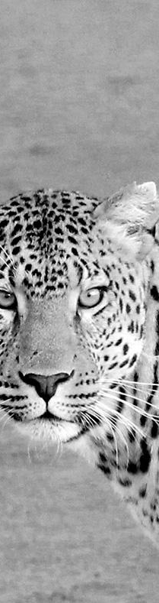
Last week
Characterization
Modeling
Predicting
Resource management

Slide 7
Terms and Definition

Slide 8
Terminology
Response variable: outcome, e .g., response time
Factors ( predictors): variables that affect the response variable, e.g., VM type, and parameter.
Levels (treatment): The values that a factor can assume, e.g., number of cores per VM
Replication: Repetition of all or some experiments.
Design: The number of experiments, the factor level and number of replications for each experiment.
E.g., Full Factorial Design with 5 replications: 3× 3 × 4 × 3 × 3 or 324 experiments, each repeated five times.

Slide 9
Types of Experimental Designs
Simple Designs: Vary one factor at a time
Not statistically efficient.
Wrong conclusions if the factors have interaction.
Full Factorial Design: All combinations.
Can find the effect of all factors.
Too much time and money.
E.g., 2 factorial where each of n factors has 2 levels. # of experiments = 2^n/
Fractional Factorial Designs: Less than Full Factorial
Save time and expense.
Less information.
May not get all interactions.
Not a problem if negligible interactions
Not recommended
Replication is important for all experiments!!!!

Slide 10
One factorial
Two factorial
Full factorial
Partial factorial

Slide 11
Analysis of results
Goodness of fit:
Errors
Variation from factor
Analysis of variation

Slide 12
One Factorial Design

Slide 13

Examples of one factor experiments

Slide 14

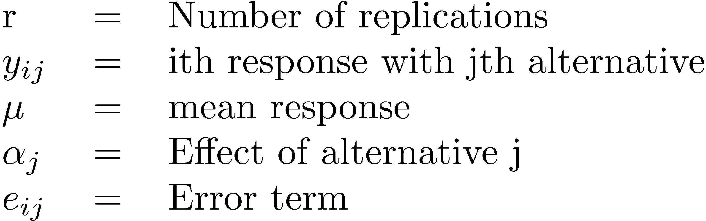

One Factor Experiments
Used to compare alternatives of a single categorical variable.

Slide 15
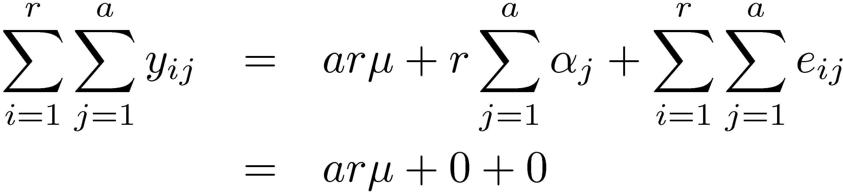
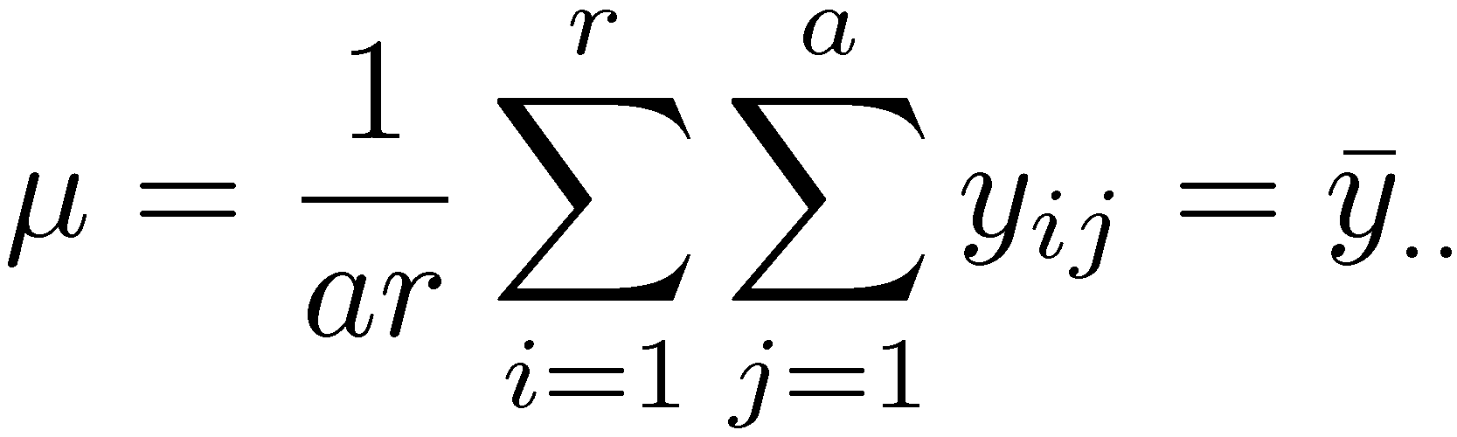
Computation of Effects

Slide 16
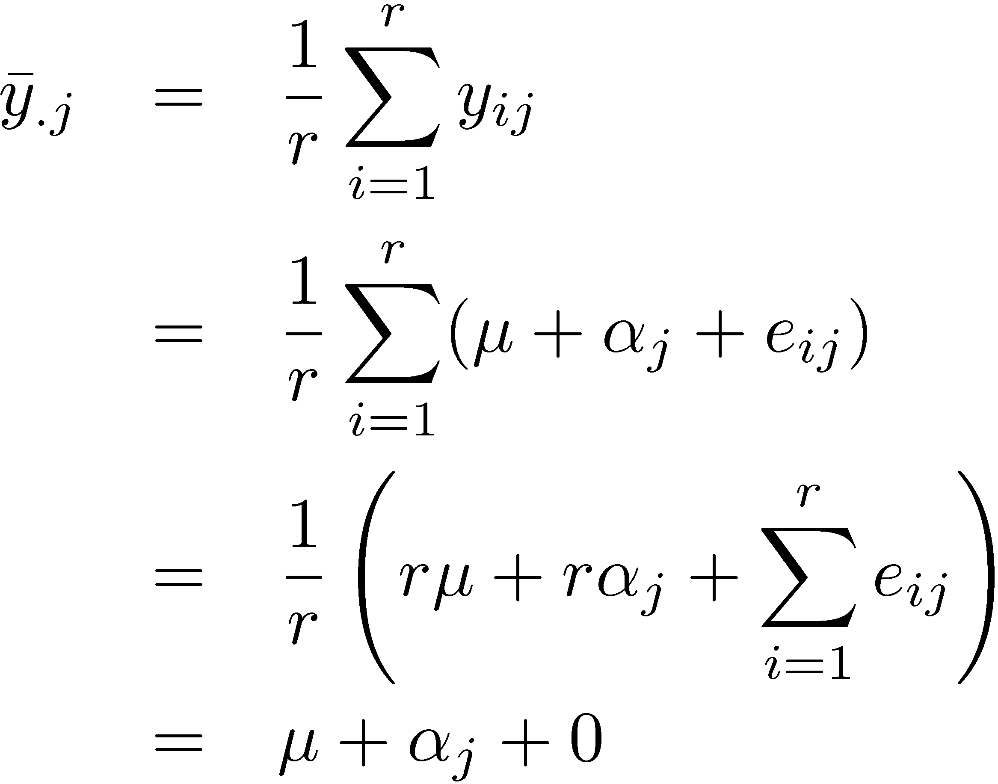

Computation of Effects (Cont)

Slide 17
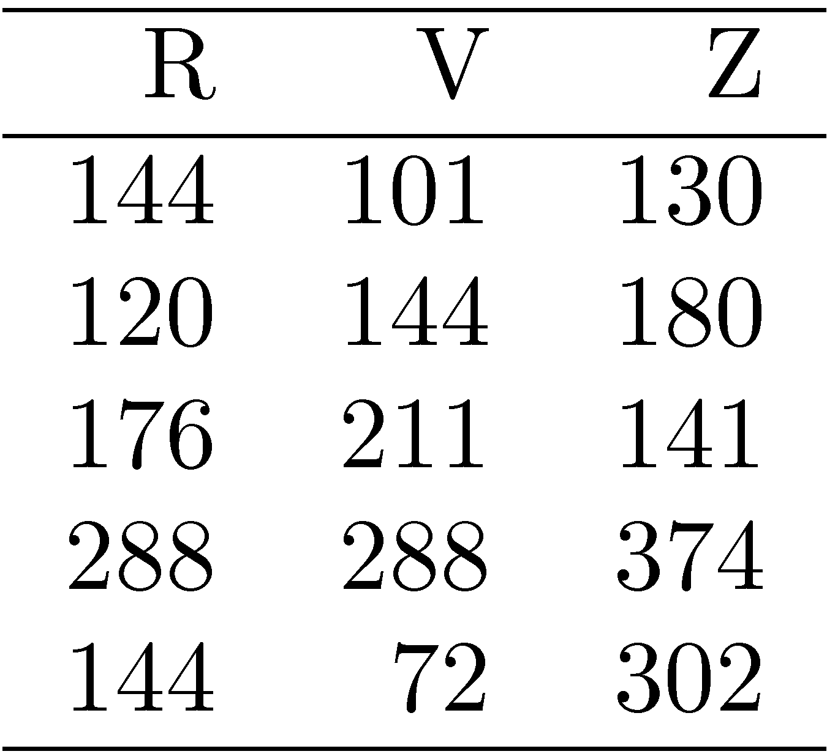
Example 20.1: Code Size Comparison
Entries in a row are unrelated.
(Otherwise, need a two factor analysis.)

Slide 18
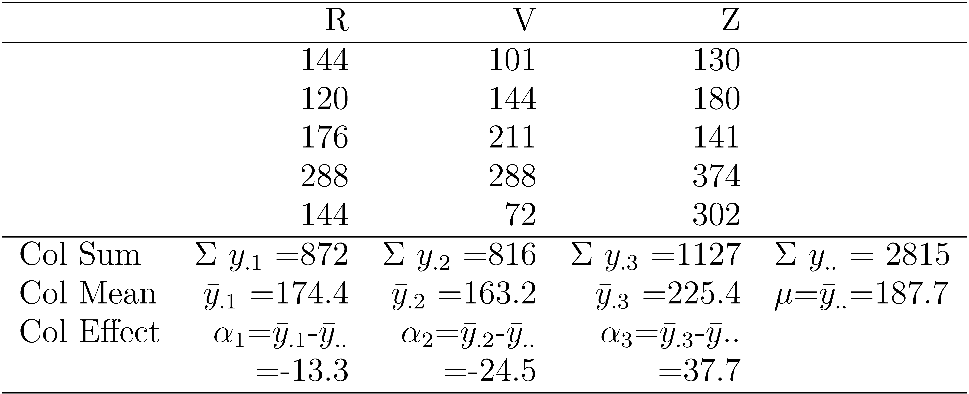
Example 20.1 Code Size (Cont)

Slide 19
Example 20.1: Interpretation
Average processor requires 187.7 bytes of storage.
The effects of the processors R, V, and Z are -13.3, -24.5, and 37.7, respectively. That is,
R requires 13.3 bytes less than an average processor
V requires 24.5 bytes less than an average processor, and
Z requires 37.7 bytes more than an average processor.

Slide 20


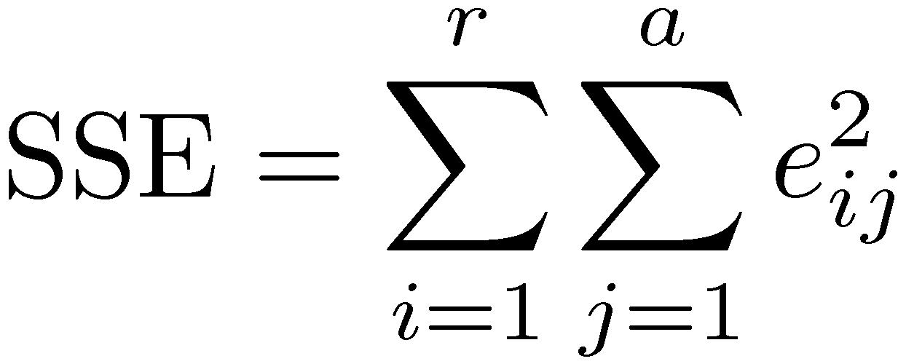
Estimating Experimental Errors
Estimated response for jth alternative:
Error:
Sum of squared errors (SSE):

Slide 21
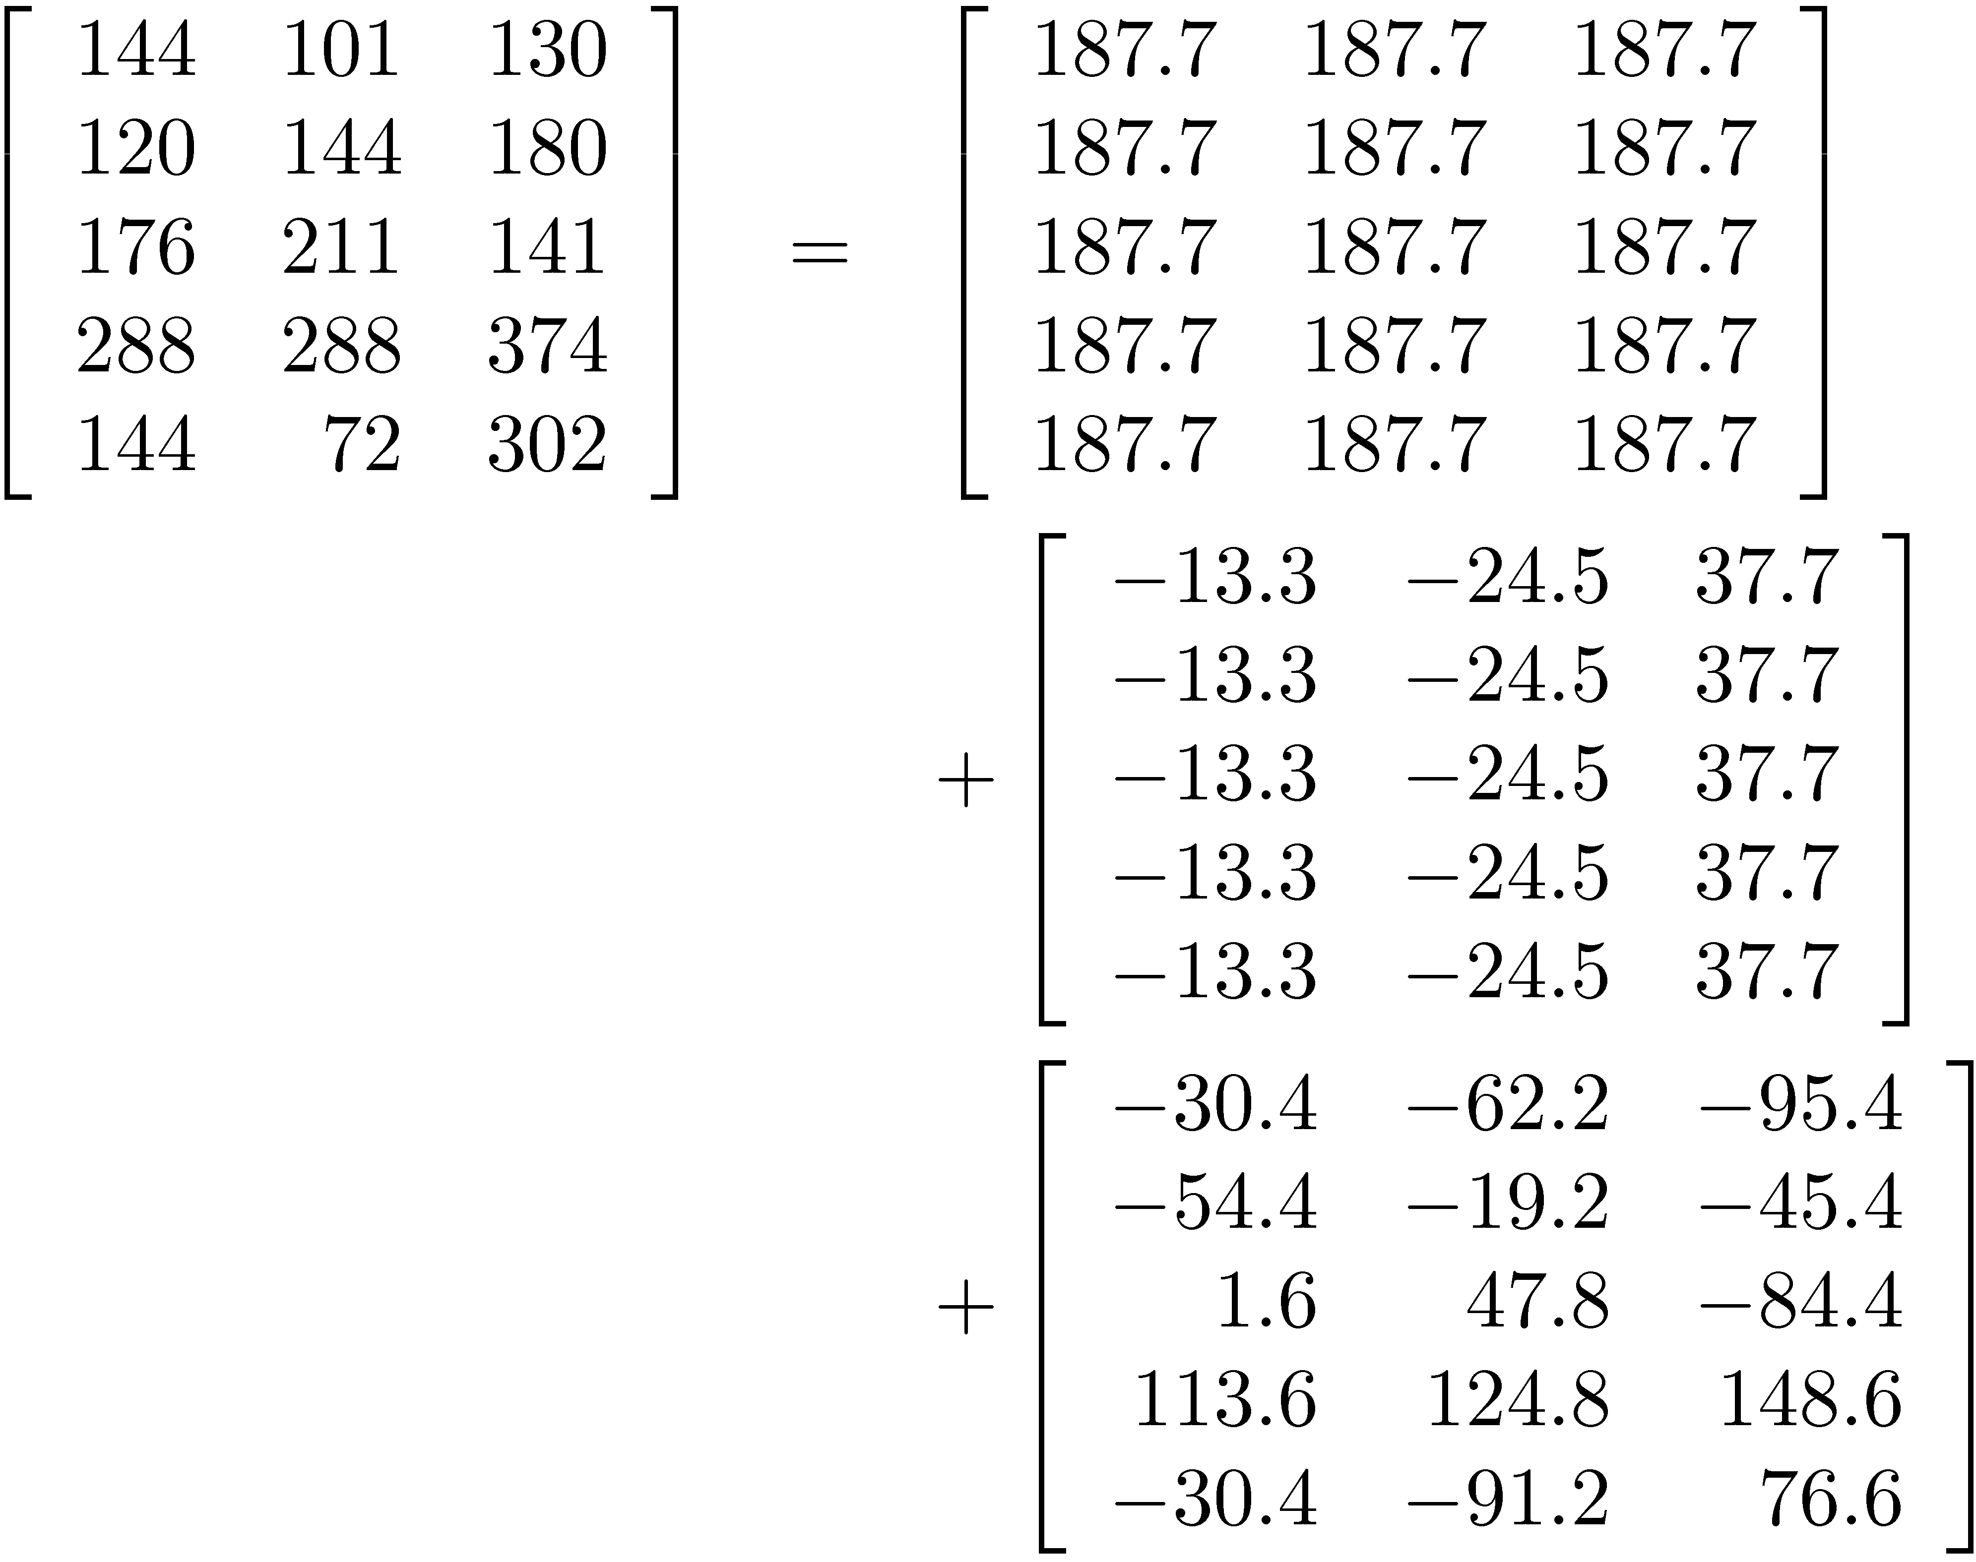
Example 20.2

Slide 22
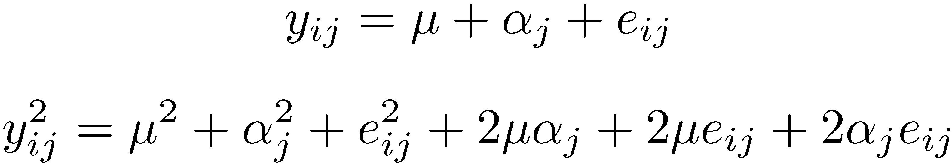
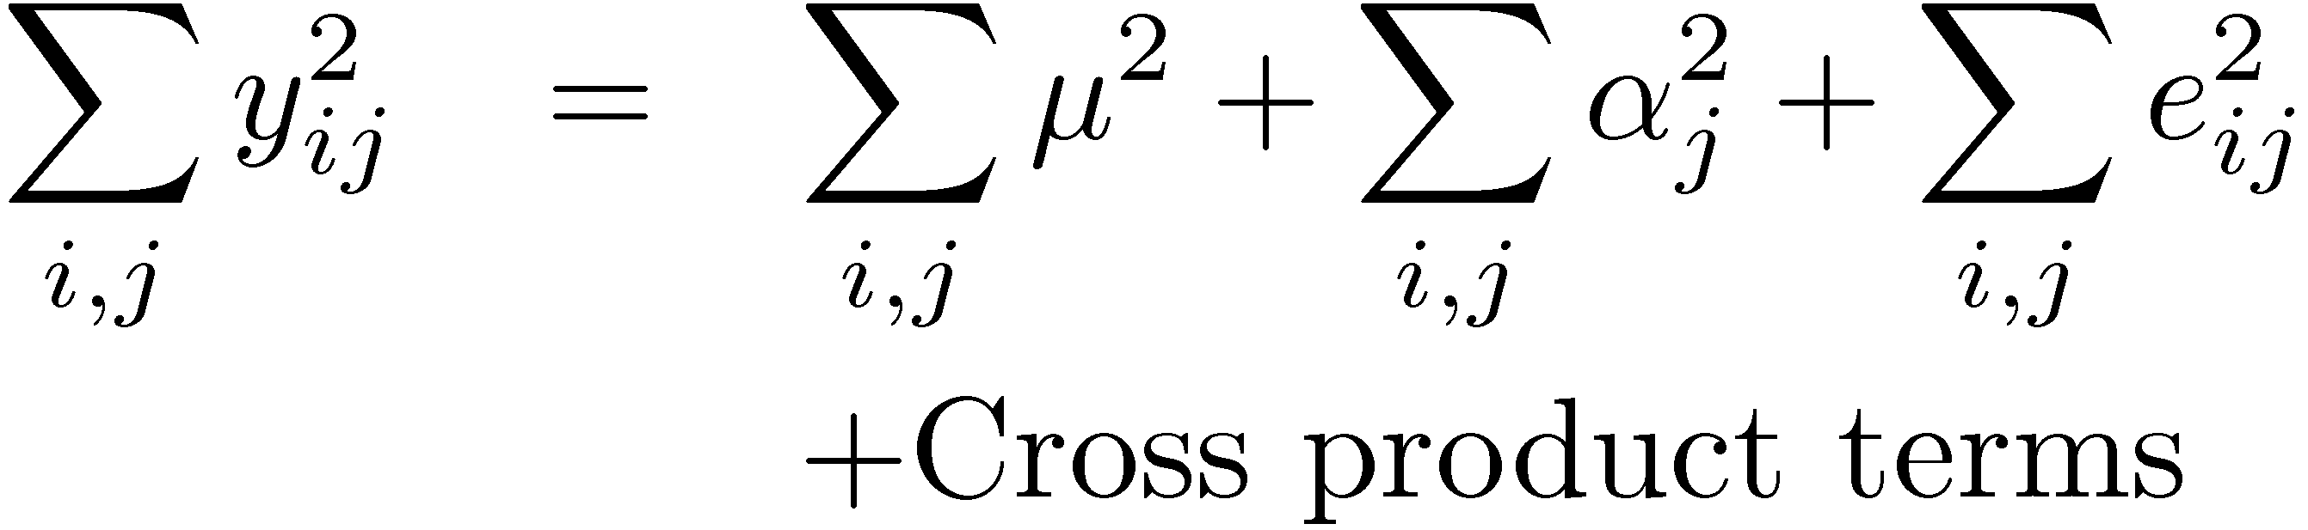
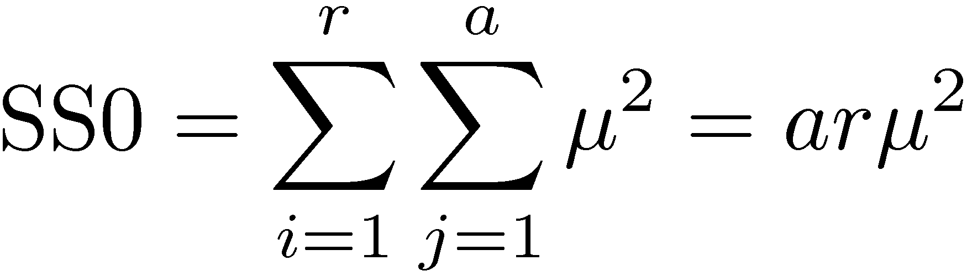
Allocation of Variation

Slide 23
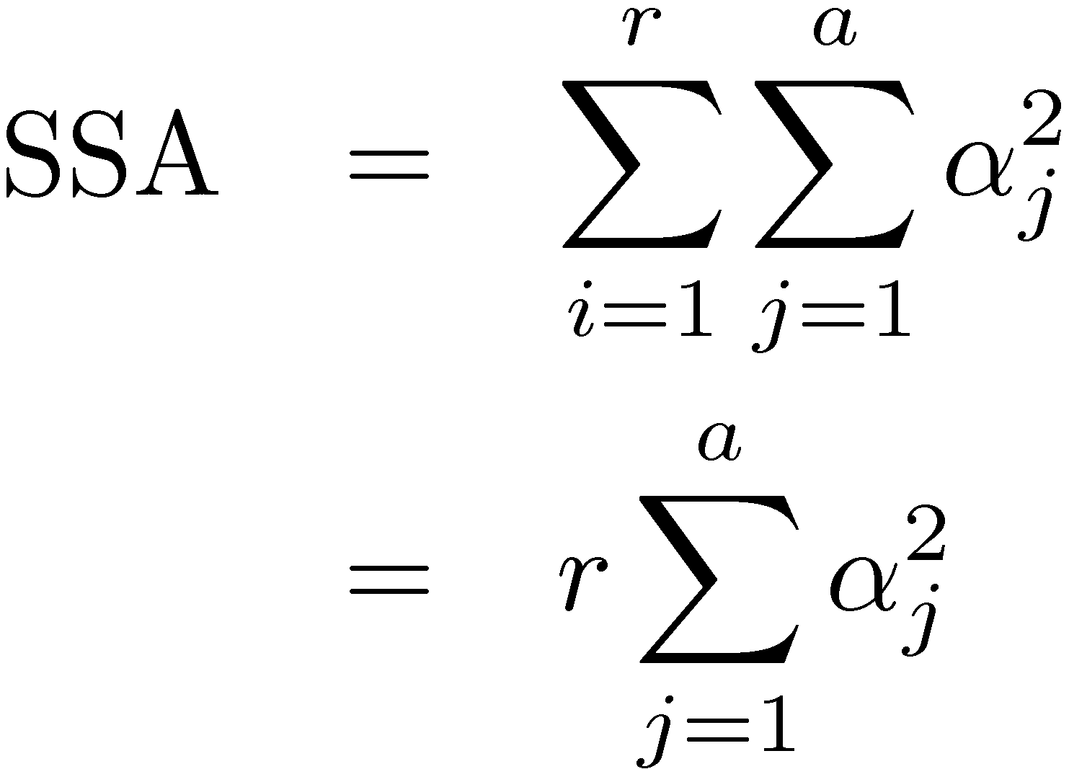
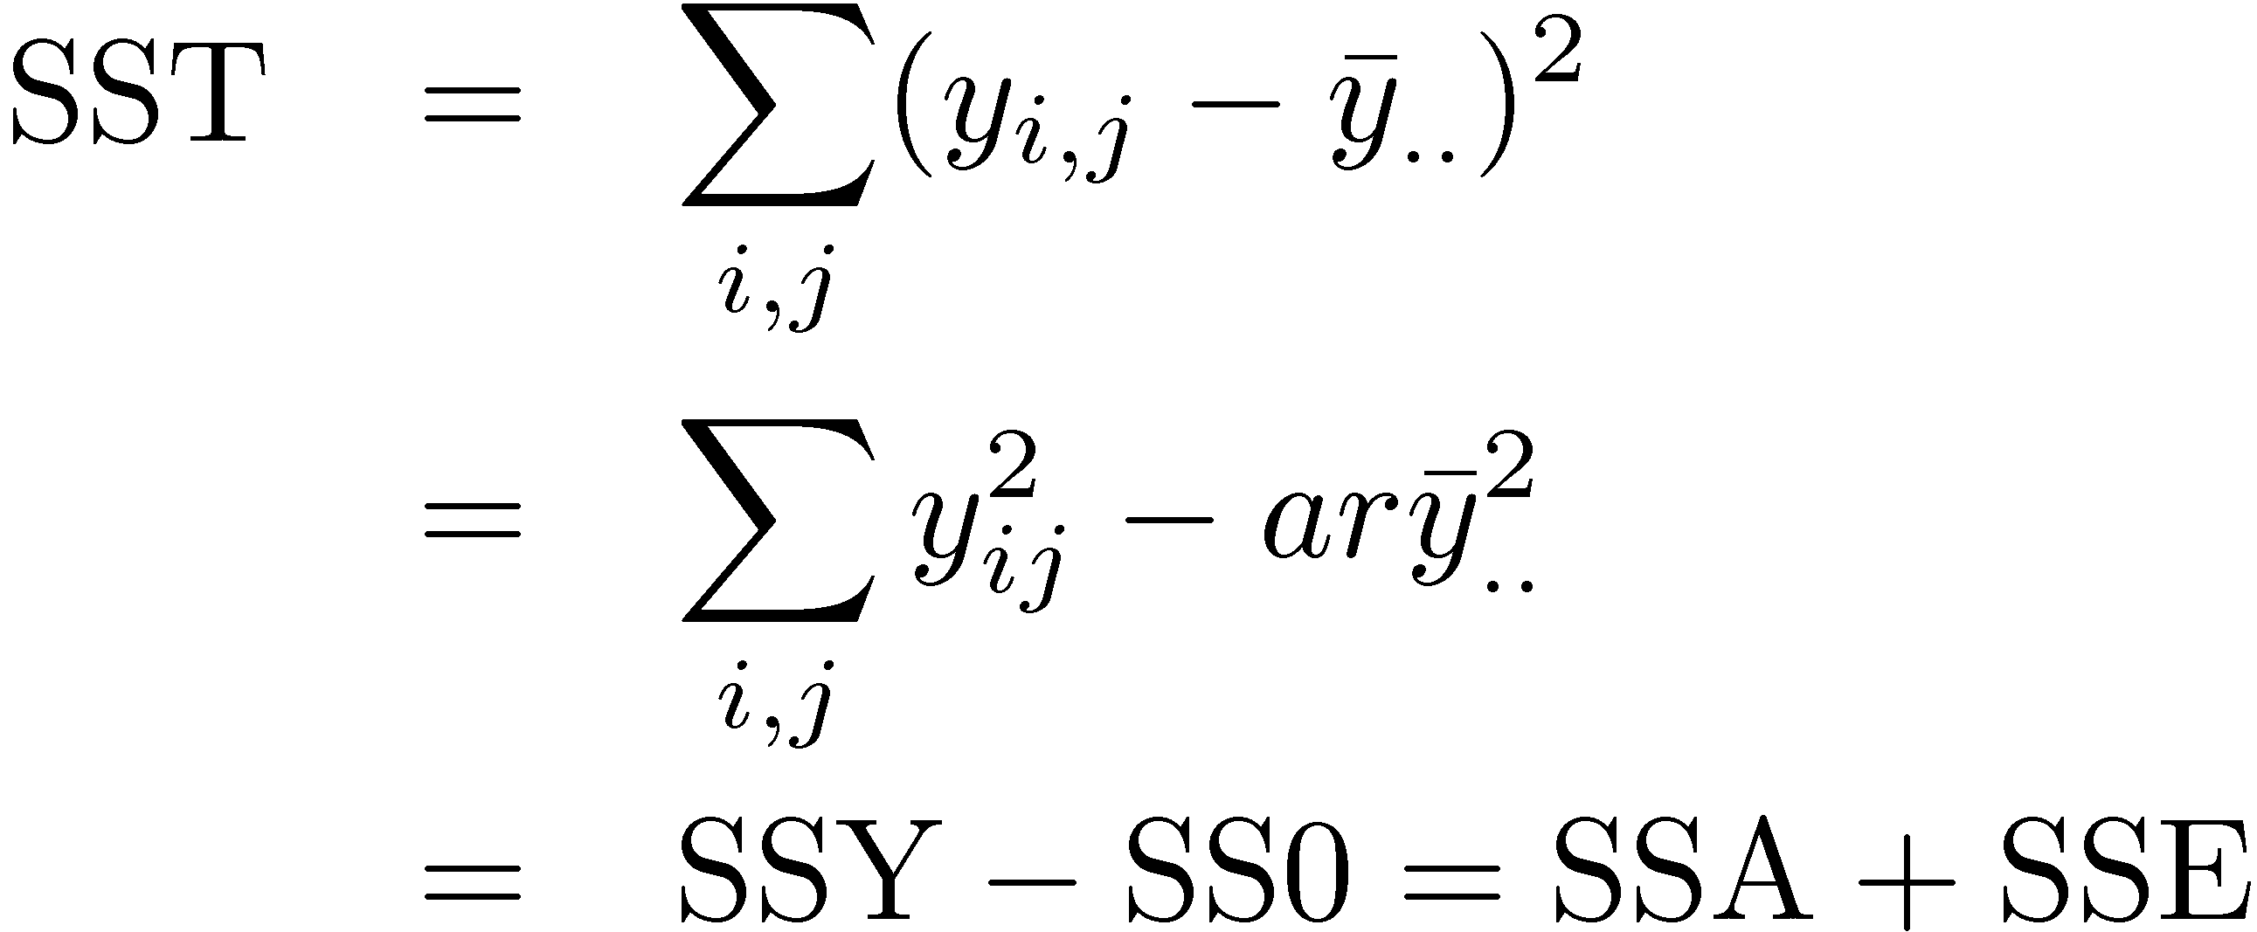
Allocation of Variation (Cont)
Total variation of y (SST):

Slide 24
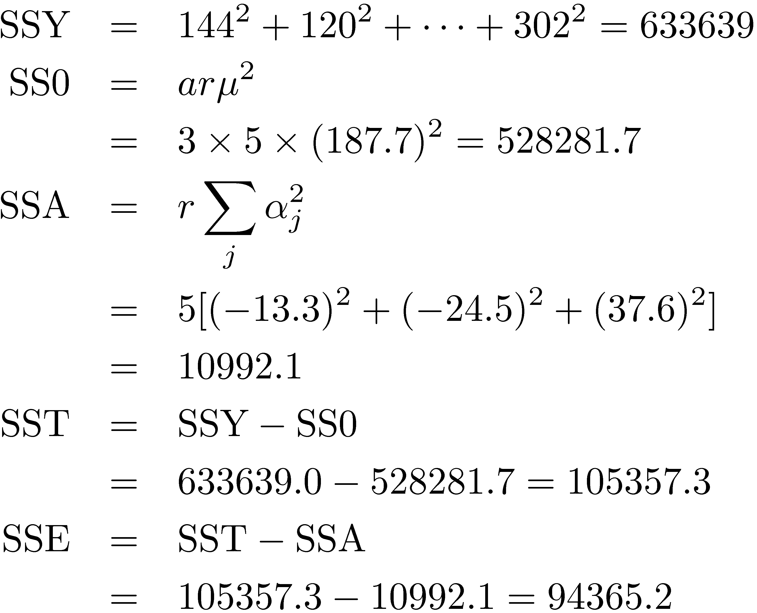
Example 20.3

Slide 25
Example 20.3 (Cont)
89.6% of variation in code size is due to experimental errors (programmer differences).
Is 10.4% statistically significant?

Slide 26
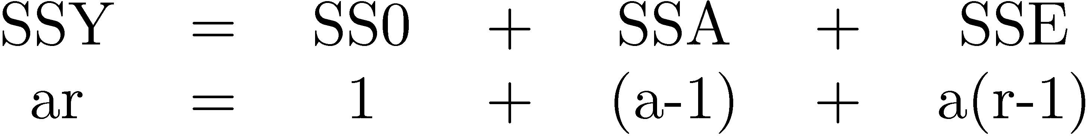
Analysis of Variance (ANOVA)
Importance ≠ Significance
Important ⇒ Explains a high percent of variation
Significance ⇒ High contribution to the variation compared to that by errors.
Degree of freedom = Number of independent values required to compute
Note that the degrees of freedom also add up.

Slide 27
F-Test
Purpose: To check if SSA is significantly greater than SSE.
Errors are normally distributed ⇒ SSE and SSA have chi-square distributions.
The ratio (SSA/ν_{Α})/(SSE/ν_{e}) has an F distribution.
where ν_{A}=a-1 = degrees of freedom for SSA
ν_{e}=a(r-1) = degrees of freedom for SSE
Computed ratio > F_{[1- α; νA, νe]}
⇒ SSA is significantly higher than SSE.
SSA/ν_{A} is called mean square of A or (MSA).
Similary, MSE=SSE/ν_{e}

Slide 28
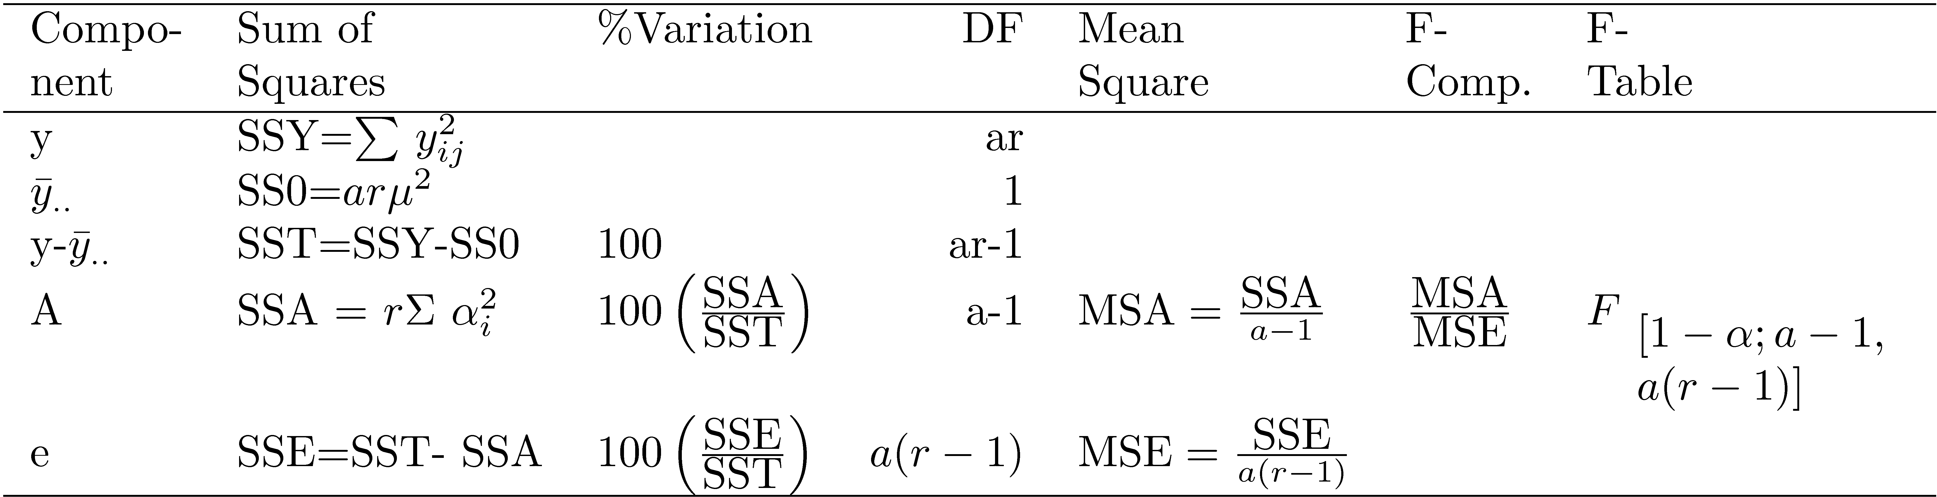
ANOVA Table for One Factor Experiments

Slide 29
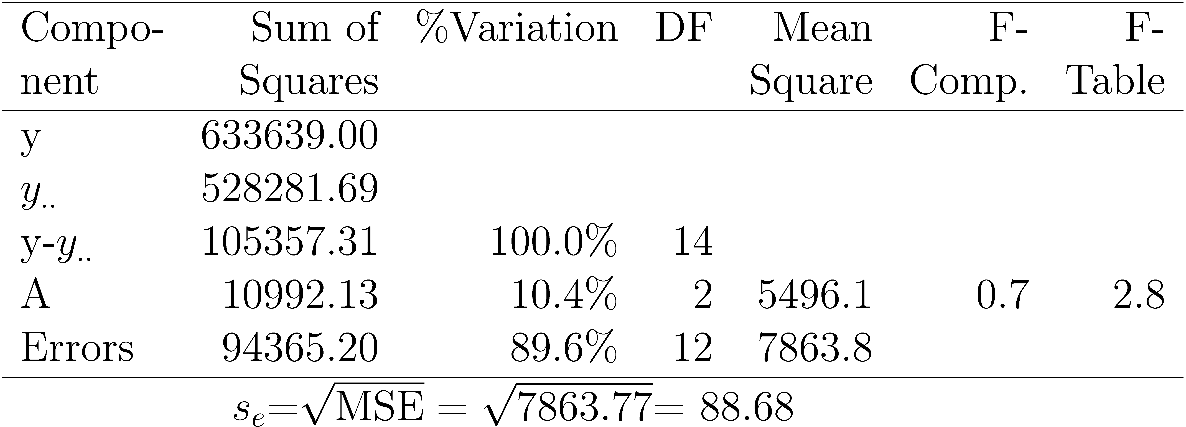
Example 20.4: Code Size Comparison
Computed F-value < F from Table
⇒ The variation in the code sizes is mostly due to experimental errors and not because of any significant difference among the processors.

Slide 30
Visual Diagnostic Tests
Assumptions:
Factors effects are additive.
Errors are additive.
Errors are independent of factor levels.
Errors are normally distributed.
Errors have the same variance for all factor levels.
Tests:
Residuals versus predicted response:
No trend ⇒ Independence
Scale of errors << Scale of response
⇒ Ignore visible trends.
Normal quantilte-quantile plot linear ⇒ Normality

Slide 31
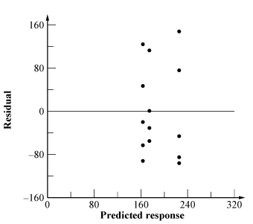
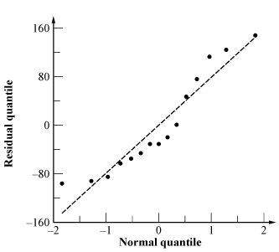
Example 20.5
Horizontal and vertical scales similar
⇒ Residuals are not small ⇒ Variation due to factors is small compared to the unexplained variation
No visible trend in the spread
Q-Q plot is S-shaped ⇒ shorter tails than normal.

Slide 32
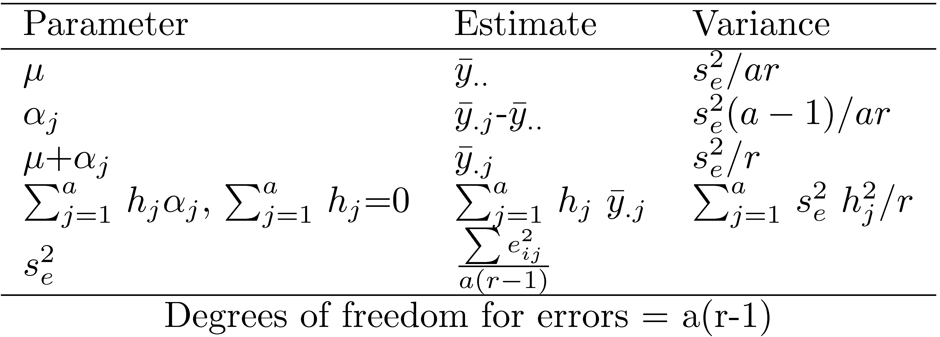

Confidence Intervals For Effects
Estimates are random variables
For the confidence intervals, use t values at a(r-1) degrees of freedom.
Mean responses:
Contrasts ∑ h_{j} α_{j}: Use for α₁-α₂

Slide 33

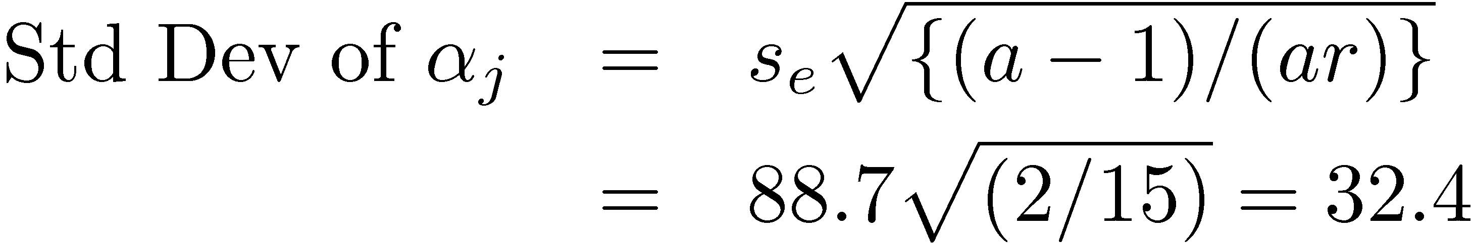
Example 20.6: Code Size Comparison

Slide 34
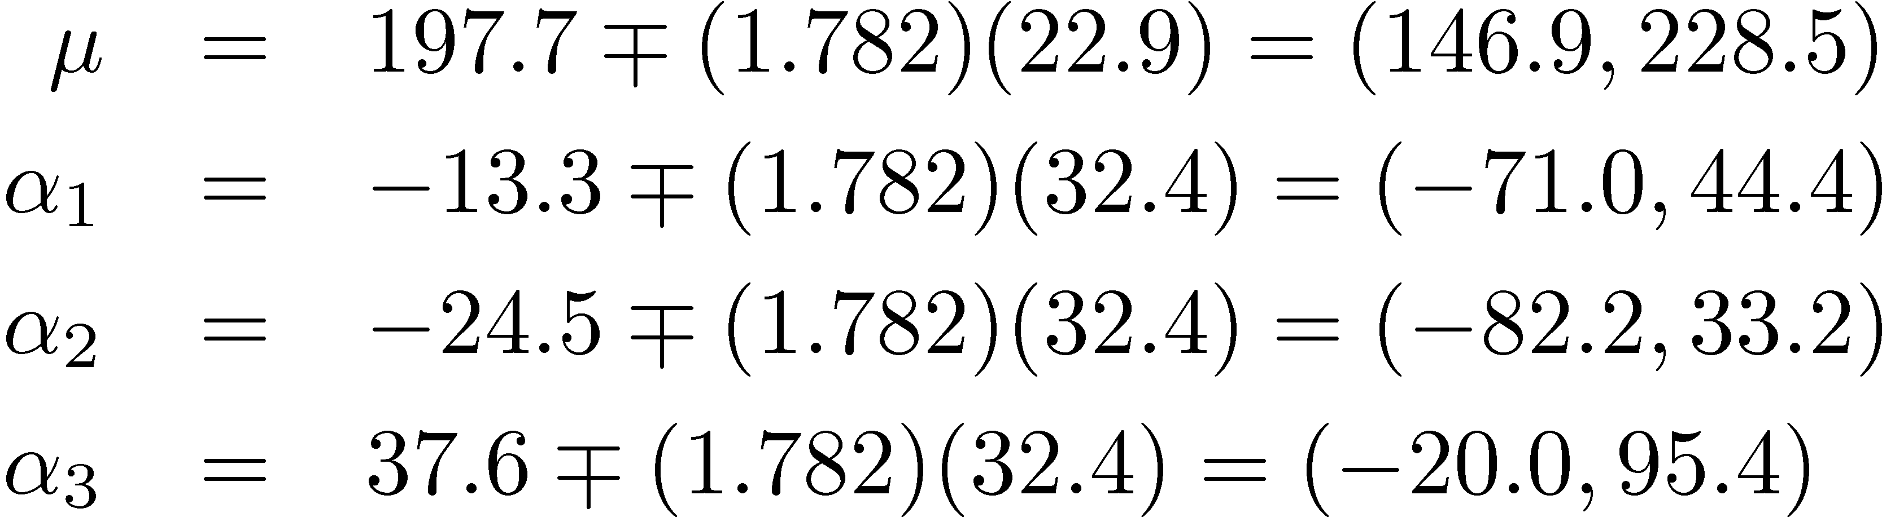
Example 20.6 (Cont)
For 90% confidence, t_{[0.95; 12]}= 1.782.
90% confidence intervals:
The code size on an average processor is significantly different from zero.
Processor effects are not significant.

Slide 35
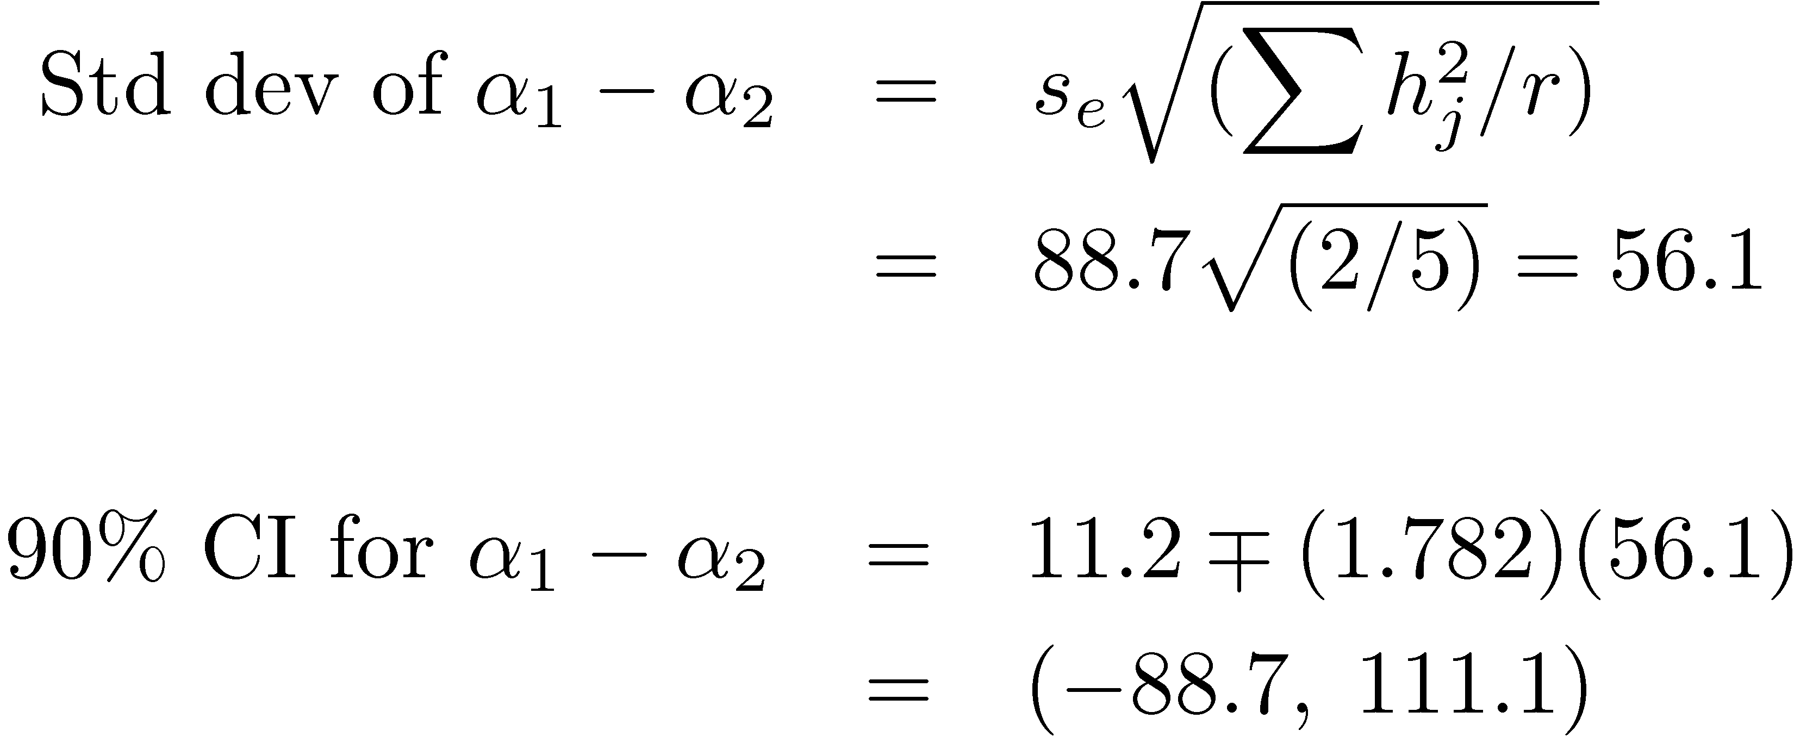
Example 20.6 (Cont)
Using h₁=1, h₂=-1, h₃=0, (∑ h_{j}=0):
CI includes zero ⇒ one isn't superior to other.

Slide 36
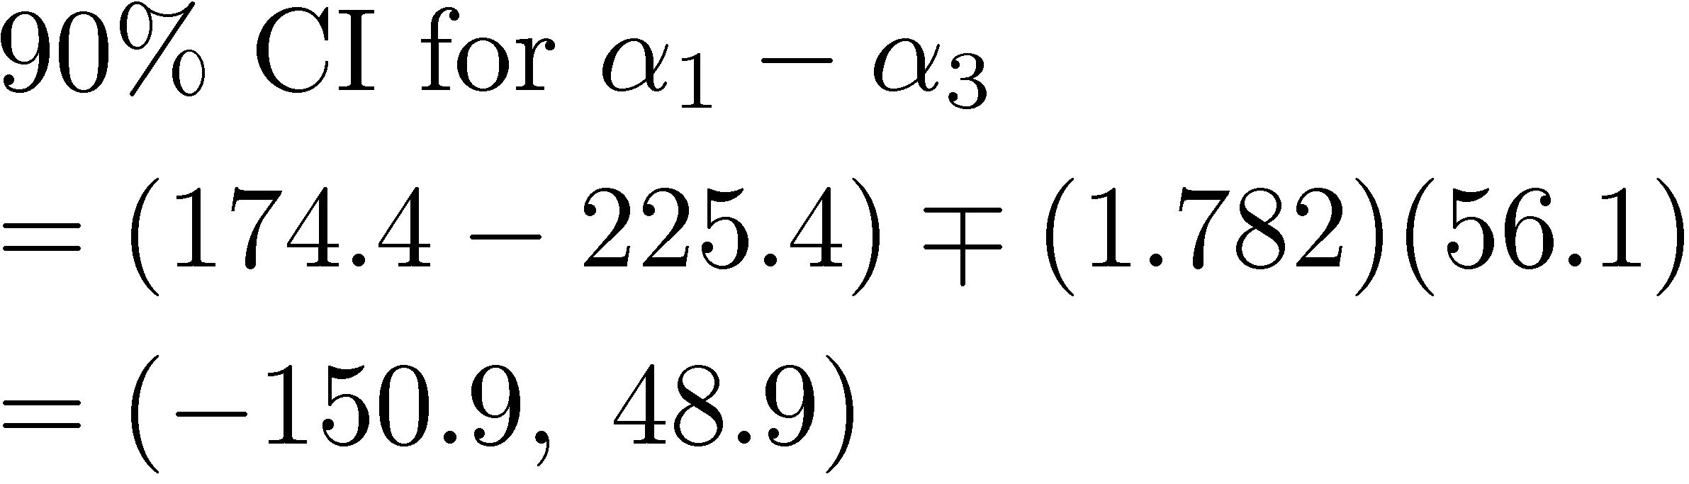
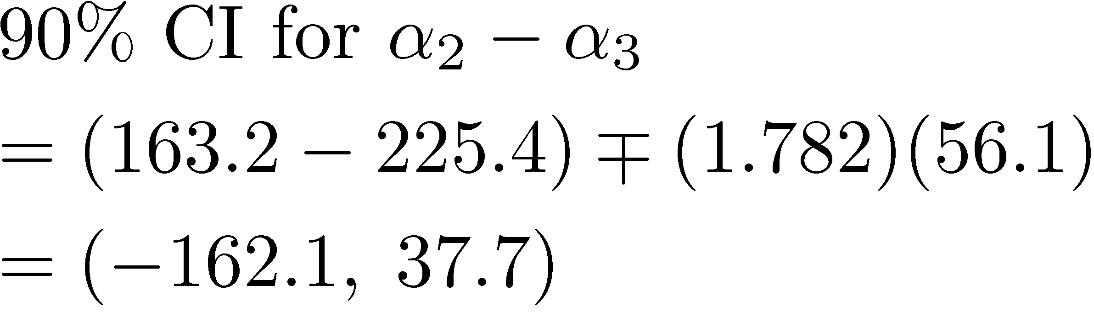
Example 20.6 (Cont)
Similarly,
Any one processor is not superior to another.

Slide 37
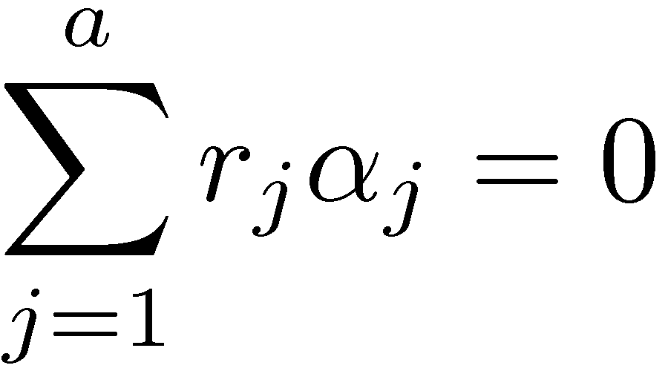
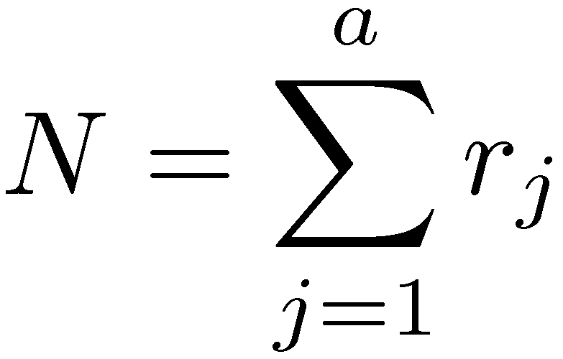
Unequal Sample Sizes
By definition:
Here, r_{j} is the number of observations at jth level.
N =total number of observations:

Slide 38
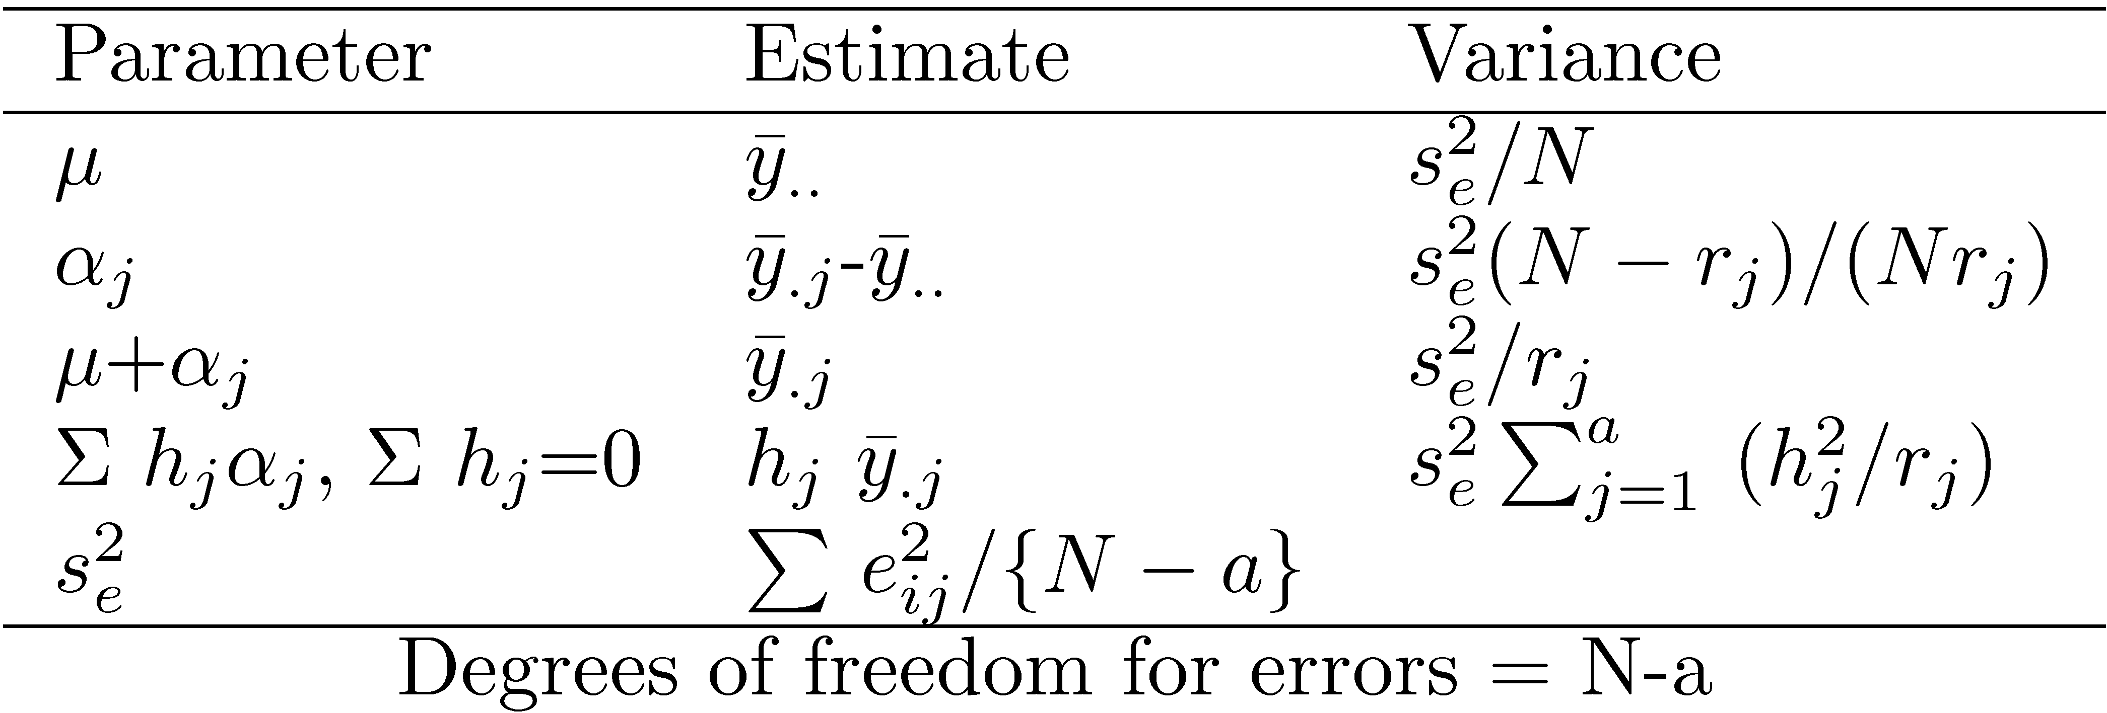
Parameter Estimation

Slide 39
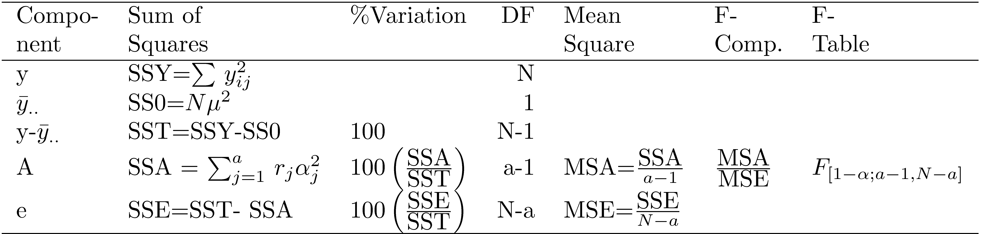
Analysis of Variance

Slide 40
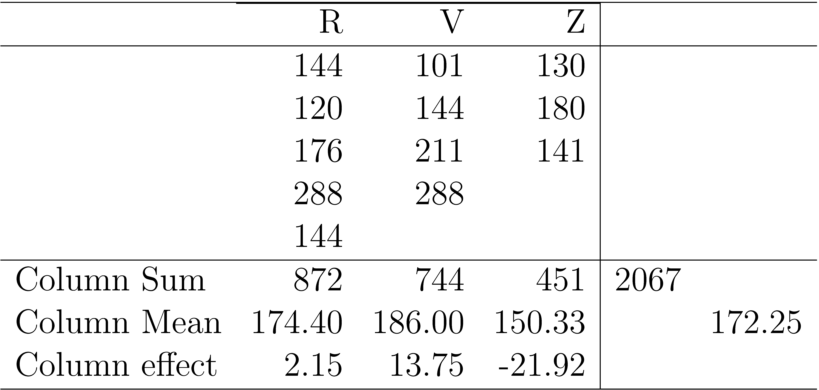
Example 20.7: Code Size Comparison
All means are obtained by dividing by the number of observations added.
The column effects are 2.15, 13.75, and -21.92.

Slide 41
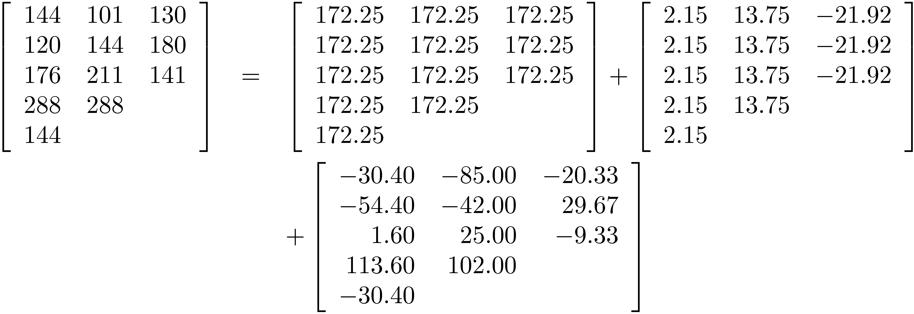
Example 20.6: Analysis of Variance

Slide 42
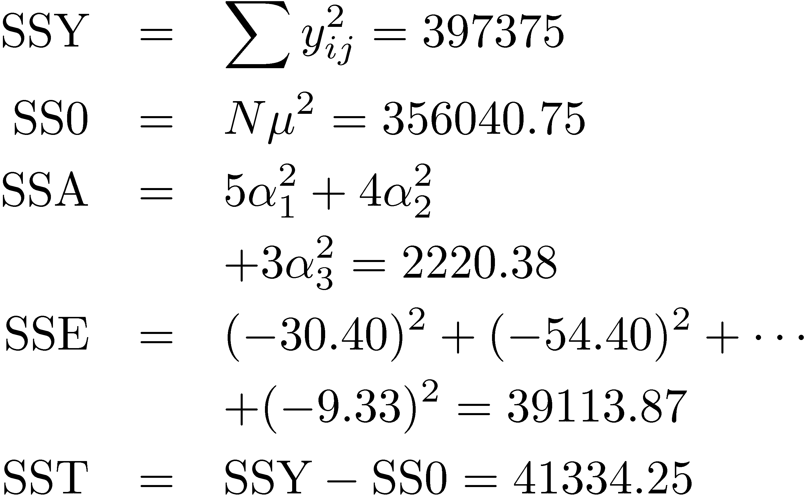
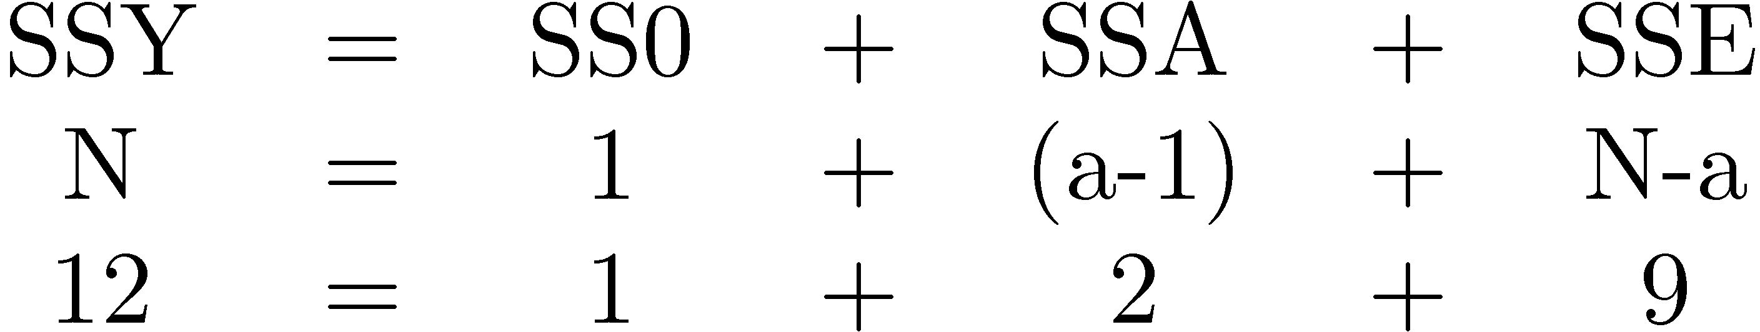
Example 20.6 ANOVA (Cont)
Sums of Squares:
Degrees of Freedom:

Slide 43
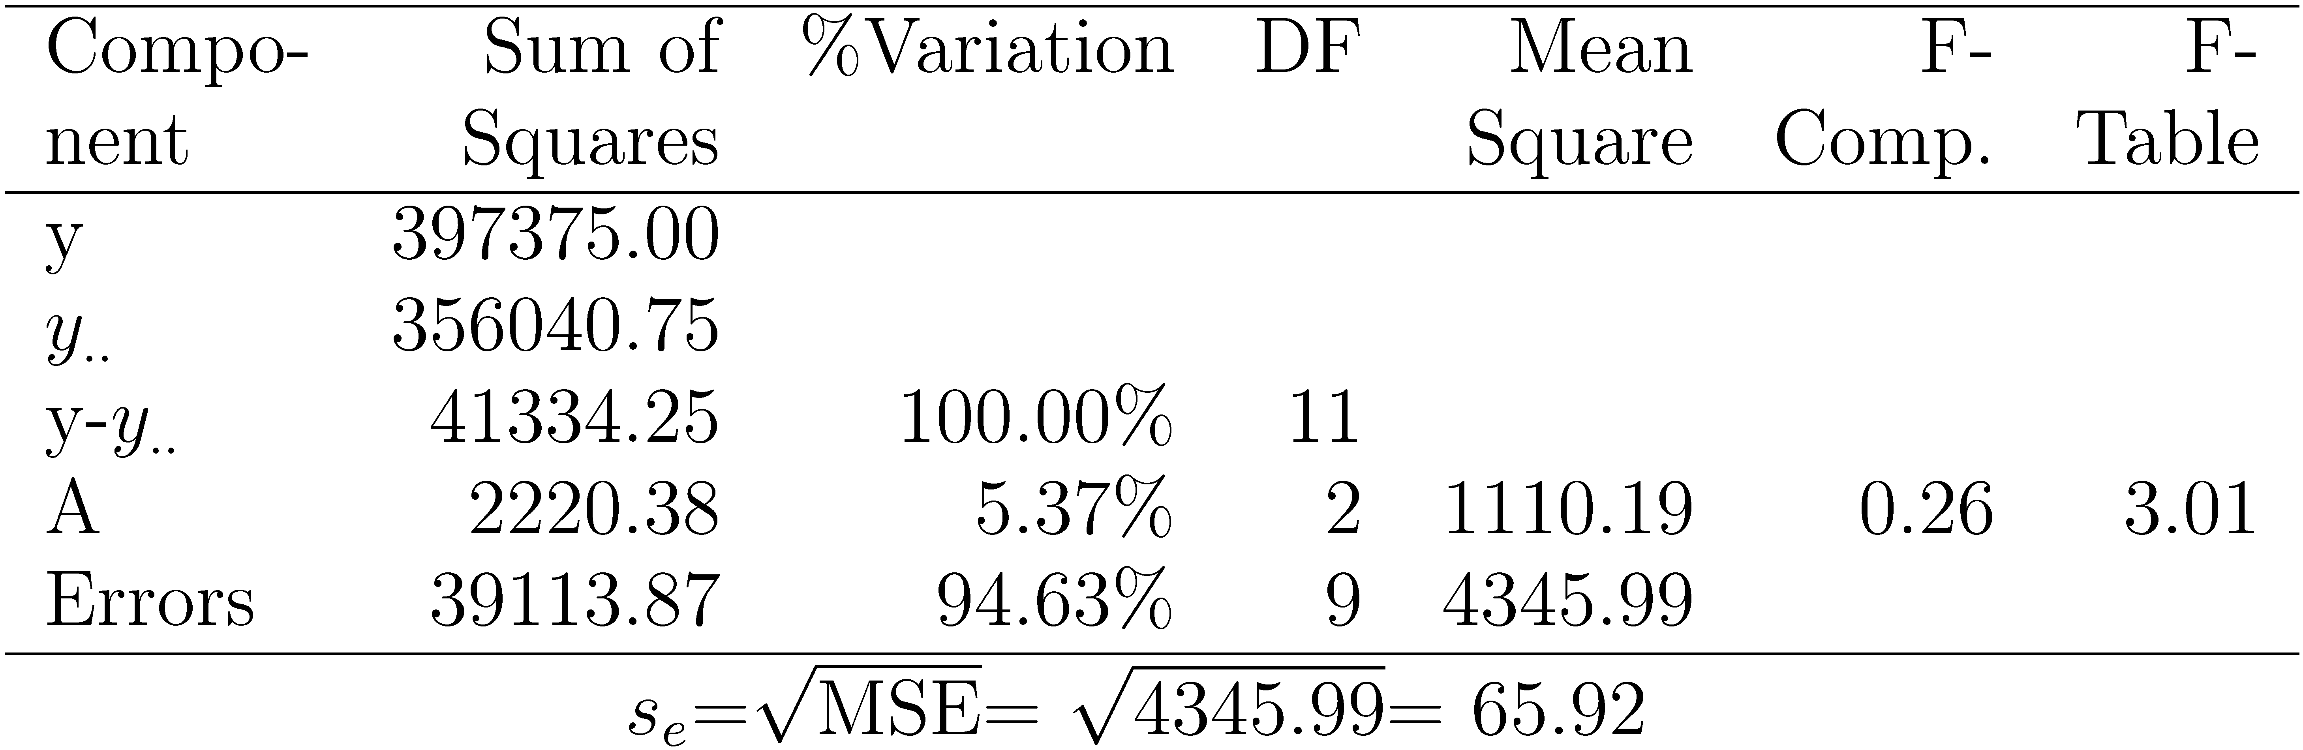
Example 20.6 ANOVA Table
Conclusion: Variation due processors is insignificant as compared to that due to modeling errors.

Slide 44
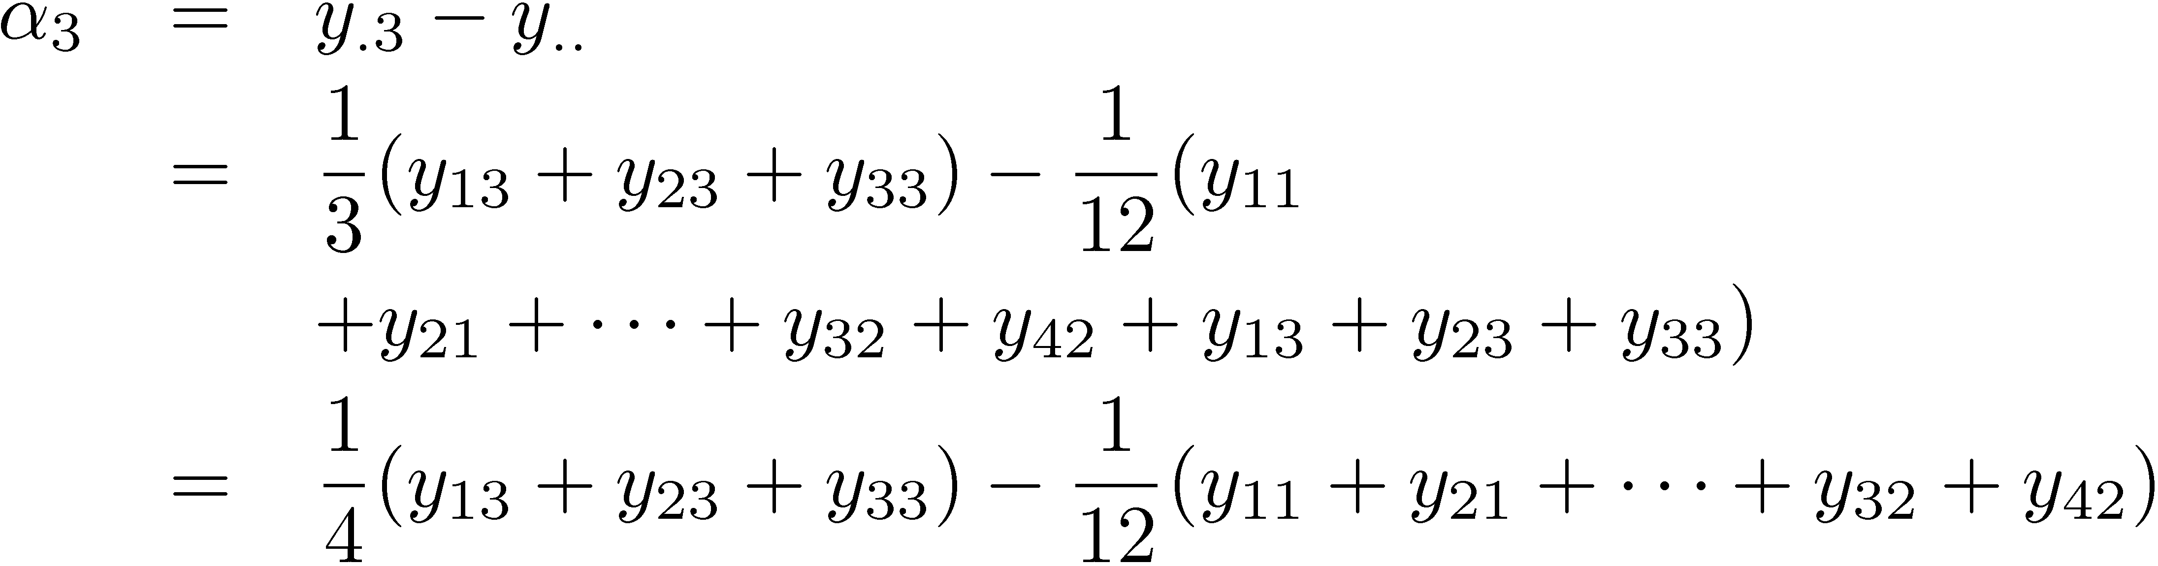
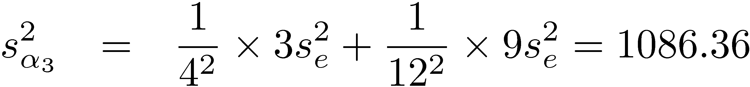
Example 20.6 Standard Dev. of Effects
Consider the effect of processor Z: Since,
Error in α₃ = ∑ Errors in terms on the right hand side:
e_{ij}'s are normally distributed ⇒ α₃ is normal with

Slide 45
Summary
Model for One factor experiments:
Computation of effects
Allocation of variation, degrees of freedom
ANOVA table
Standard deviation of errors
Confidence intervals for effects and contracts
Model assumptions and visual tests

Slide 46
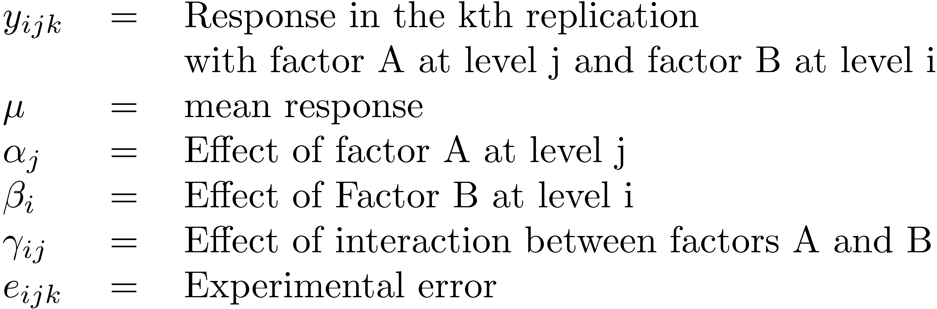
Two factorial
Replications allow separating out the interactions from experimental errors.
Model: With r replications
Here,

Slide 47
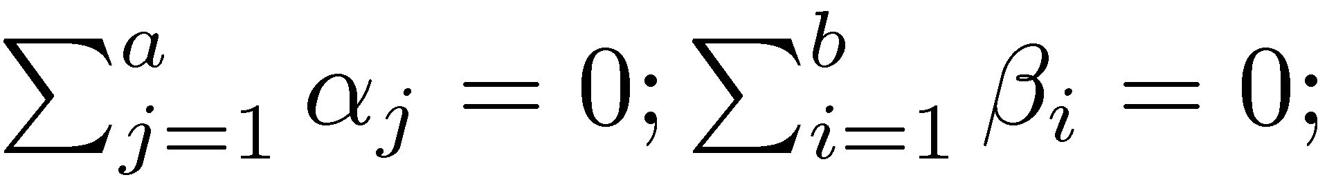
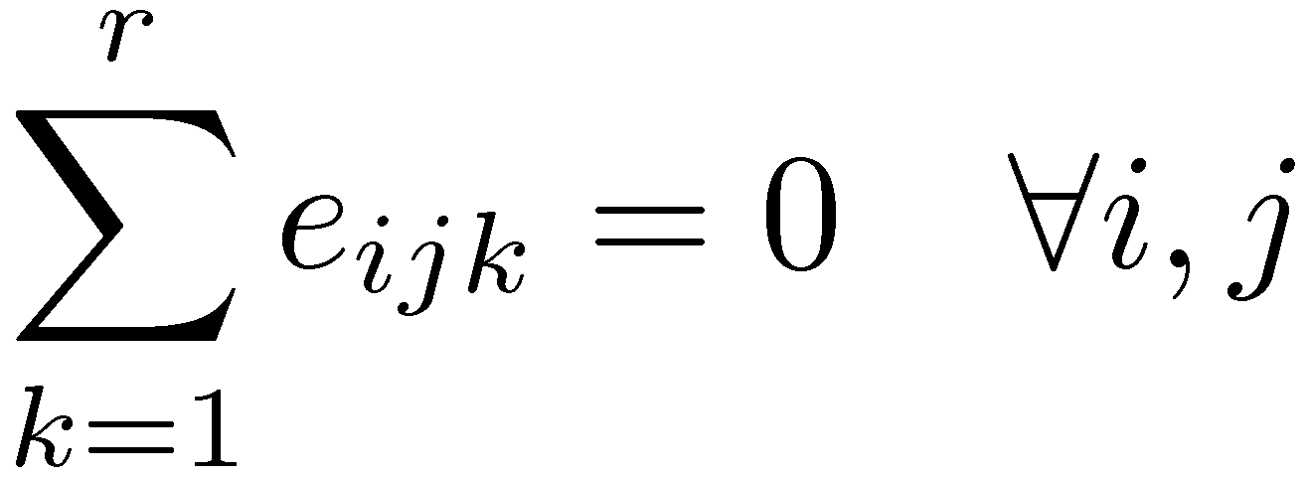
Model (Cont)
The effects are computed so that their sum is zero:
The interactions are computed so that their row as well as column sums are zero:
The errors in each experiment add up to zero:

Slide 48

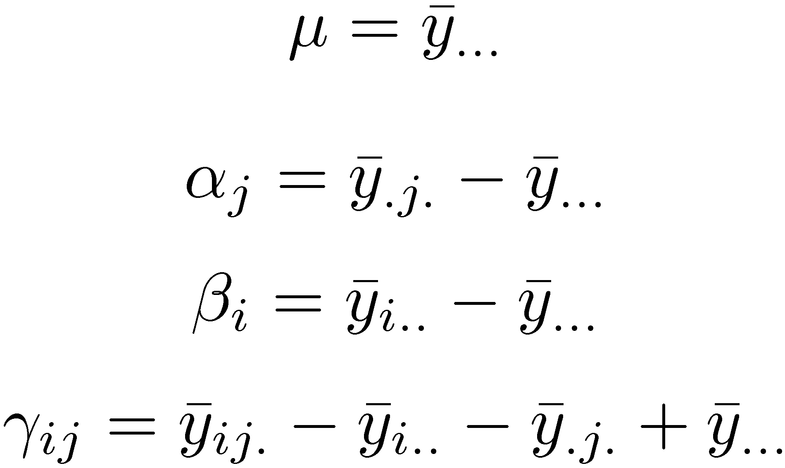



Computation of Effects
Averaging the observations in each cell:
Similarly,
⇒ Use cell means to compute row and column effects.

Slide 49
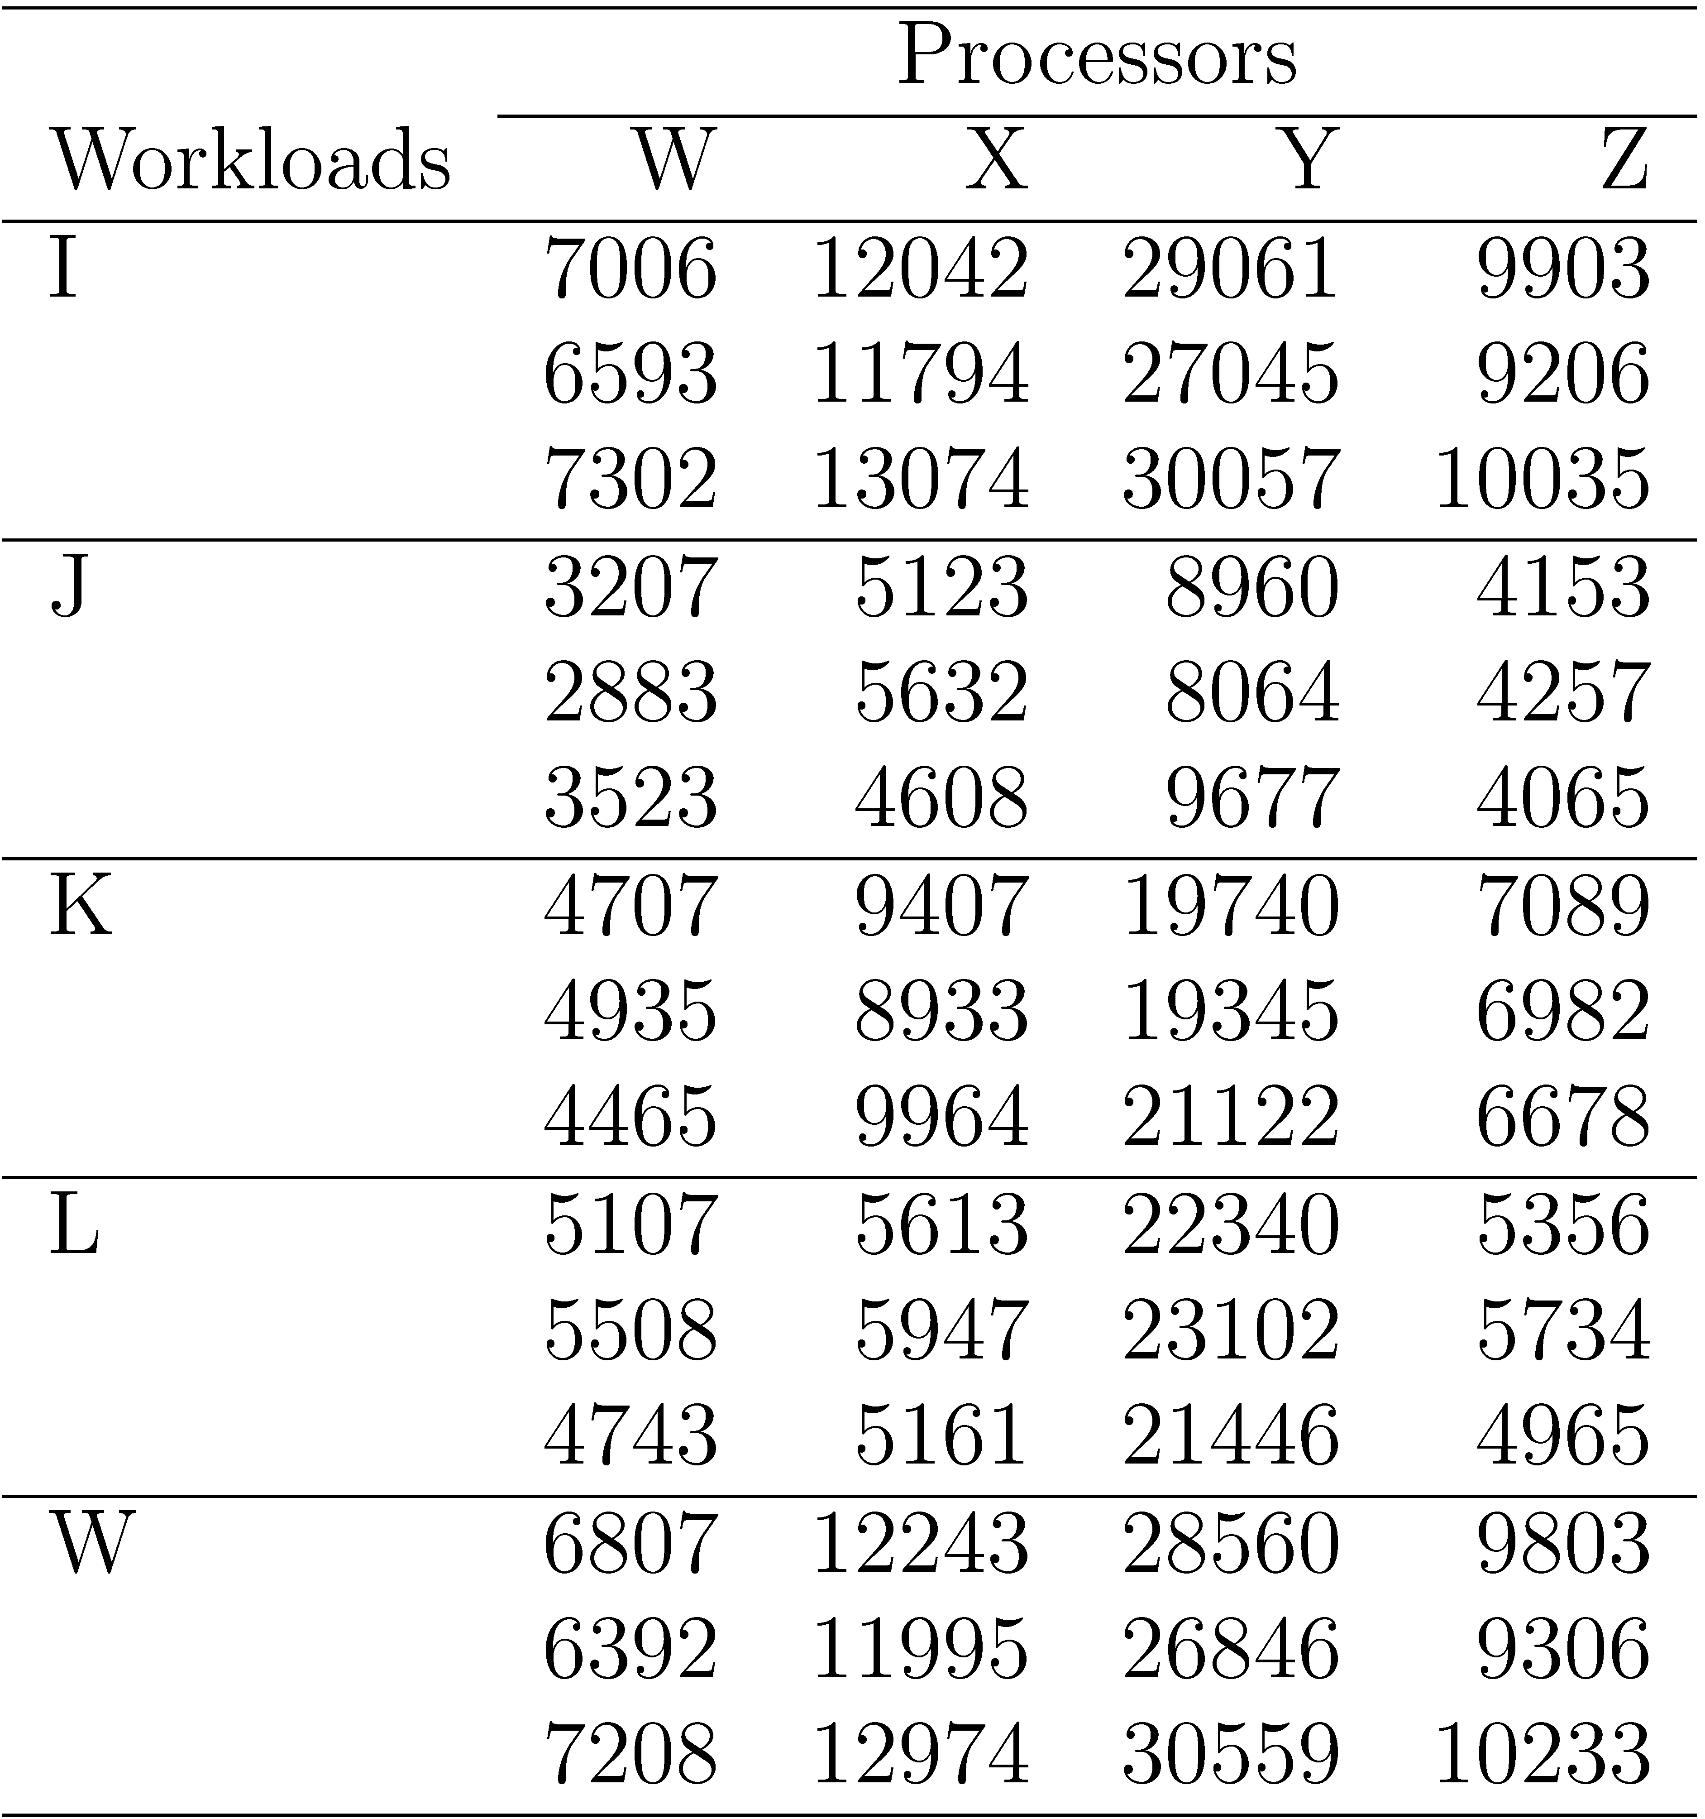
Example 22.1: Code Size

Slide 50
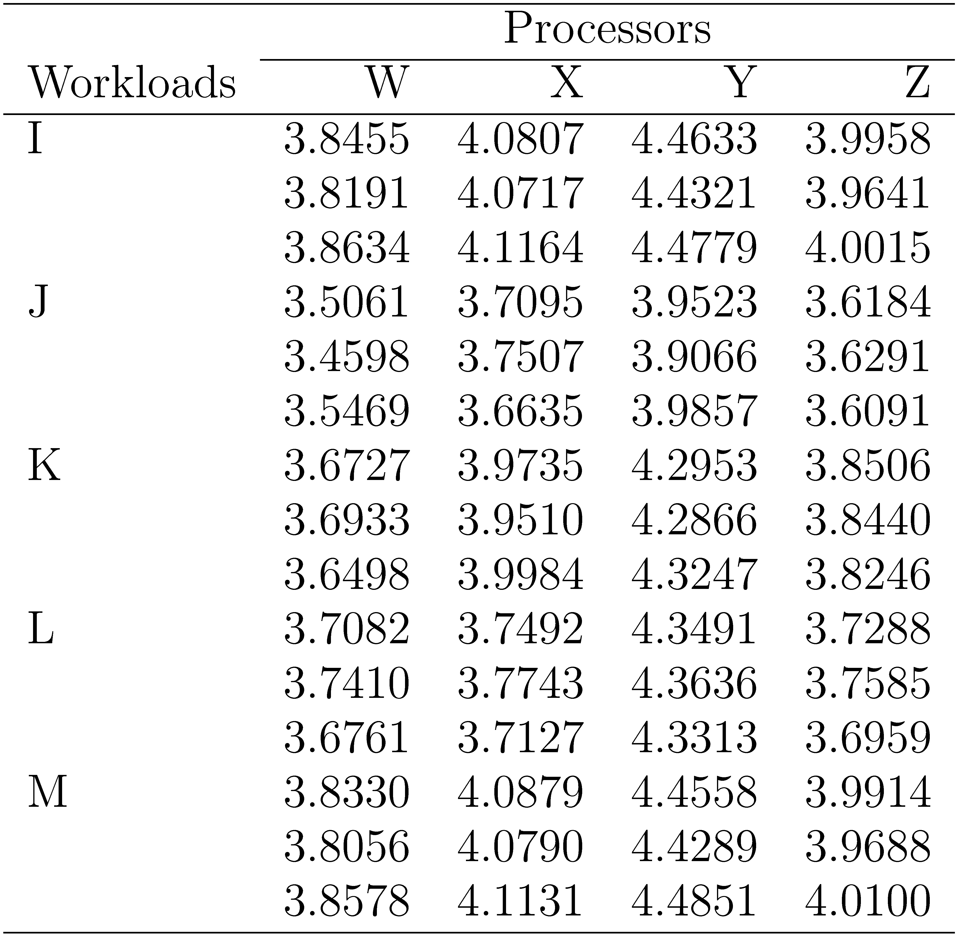
Example 22.1: Log Transformation

Slide 51
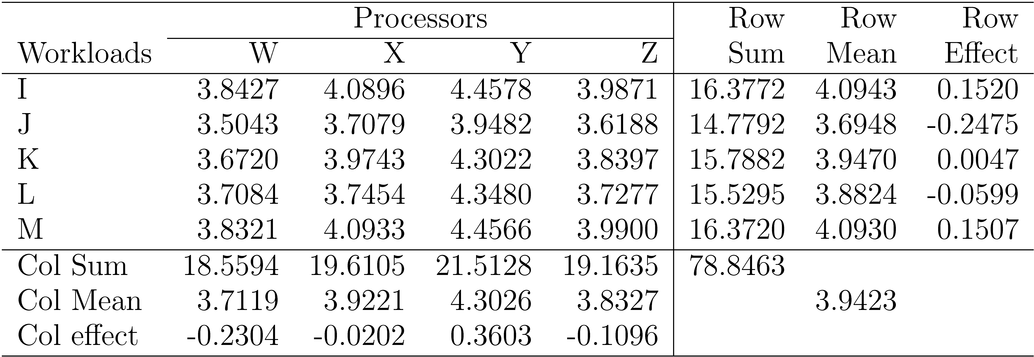
Example 22.1: Computation of Effects
An average workload on an average processor requires a code size of 10^{3.94} (8710 instructions).
Processor W requires 10^{0.23} (=1.69) less code than avg processor.
Processor X requires 10^{0.02} (=1.05) less than an average processor and so on.
The ratio of code sizes of an average workload on processor W and X is 10^{0.21} (= 1.62).

Slide 52
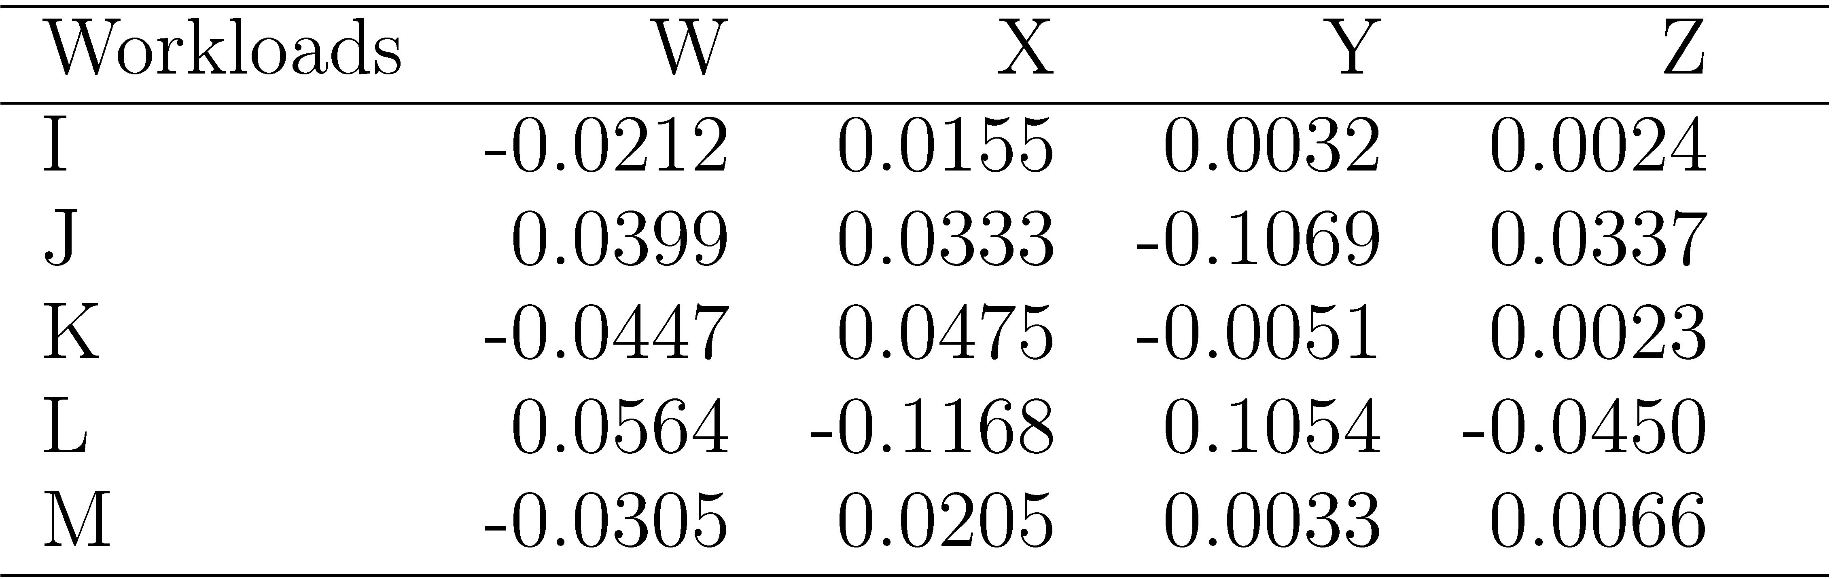
Example 22.1: Interactions
Check: The row as well column sums of interactions are zero.
Interpretation: Workload I on processor W requires 0.02 less log code size than an average workload on processor W or equivalently 0.02 less log code size than I on an average processor.

Slide 53

Computation of Errors
Estimated Response:
Error in the kth replication:
Example 22.2: Cell mean for (1,1) = 3.8427
Errors in the observations in this cell are:
3.8455-3.8427 = 0.0028
3.8191-3.8427 = -0.0236, and
3.8634-3.8427 = 0.0208
Check: Sum of the three errors is zero.

Slide 54
Allocation of Variation
Interactions explain less than 5% of variation ⇒ may be ignored.

Slide 55
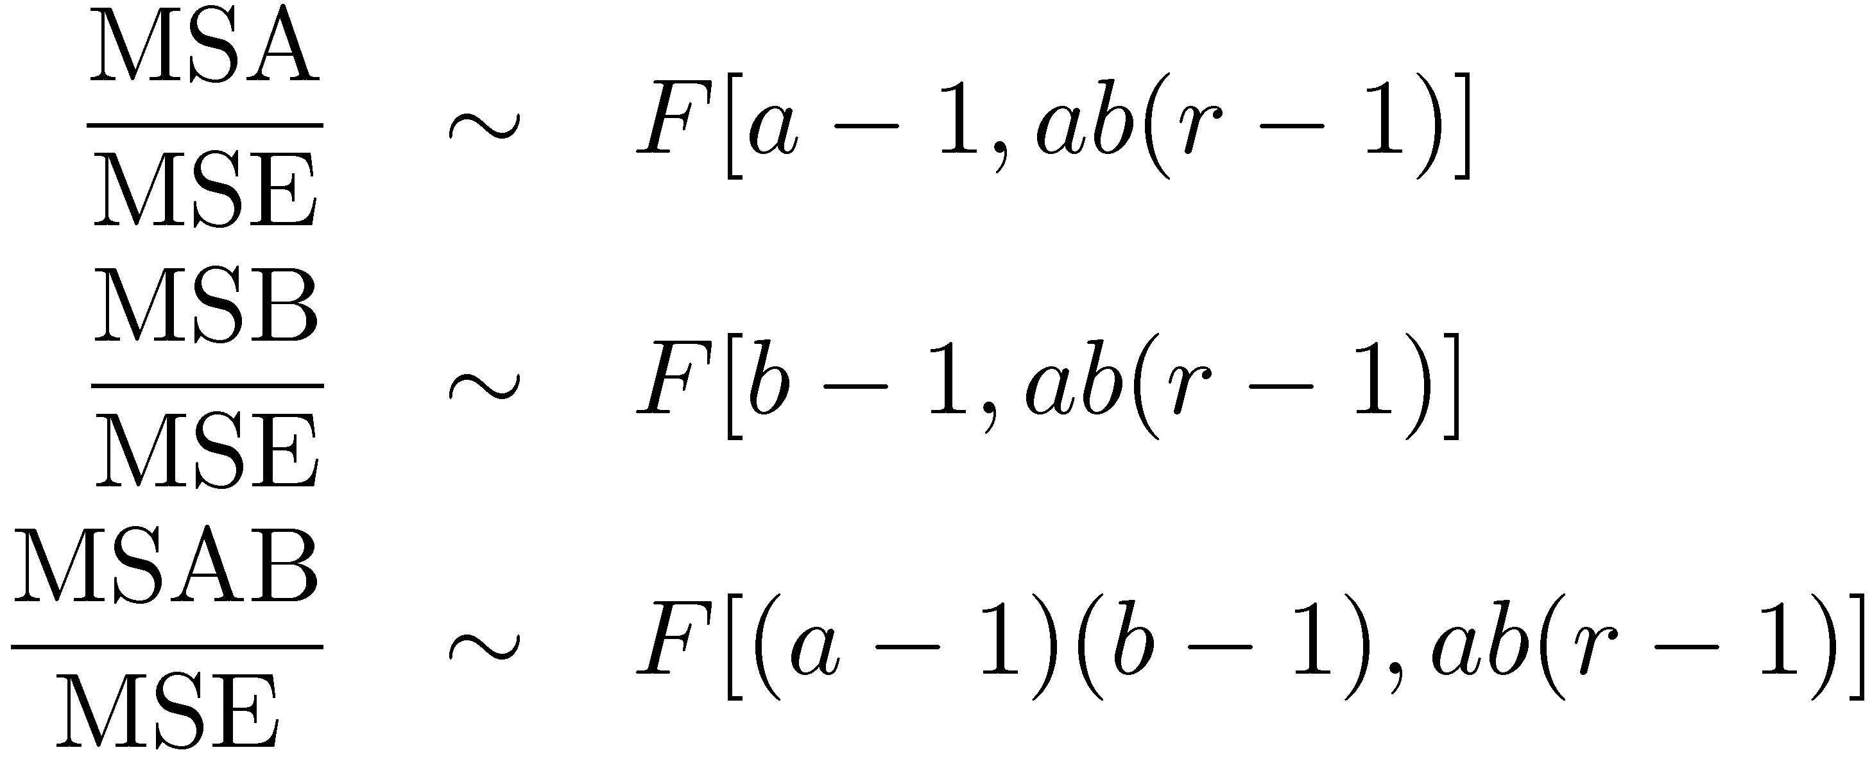
Analysis of Variance
Degrees of freedoms:

Slide 56
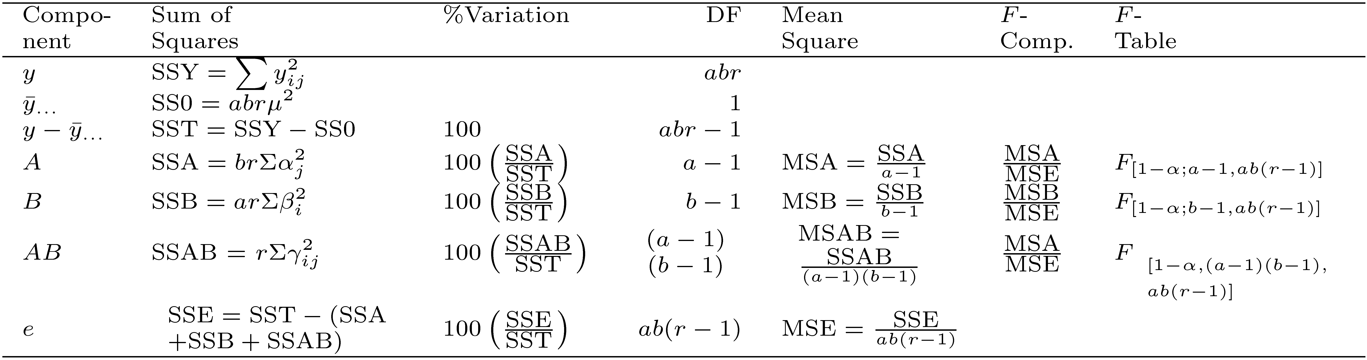
ANOVA for Two Factors w Replications

Slide 57
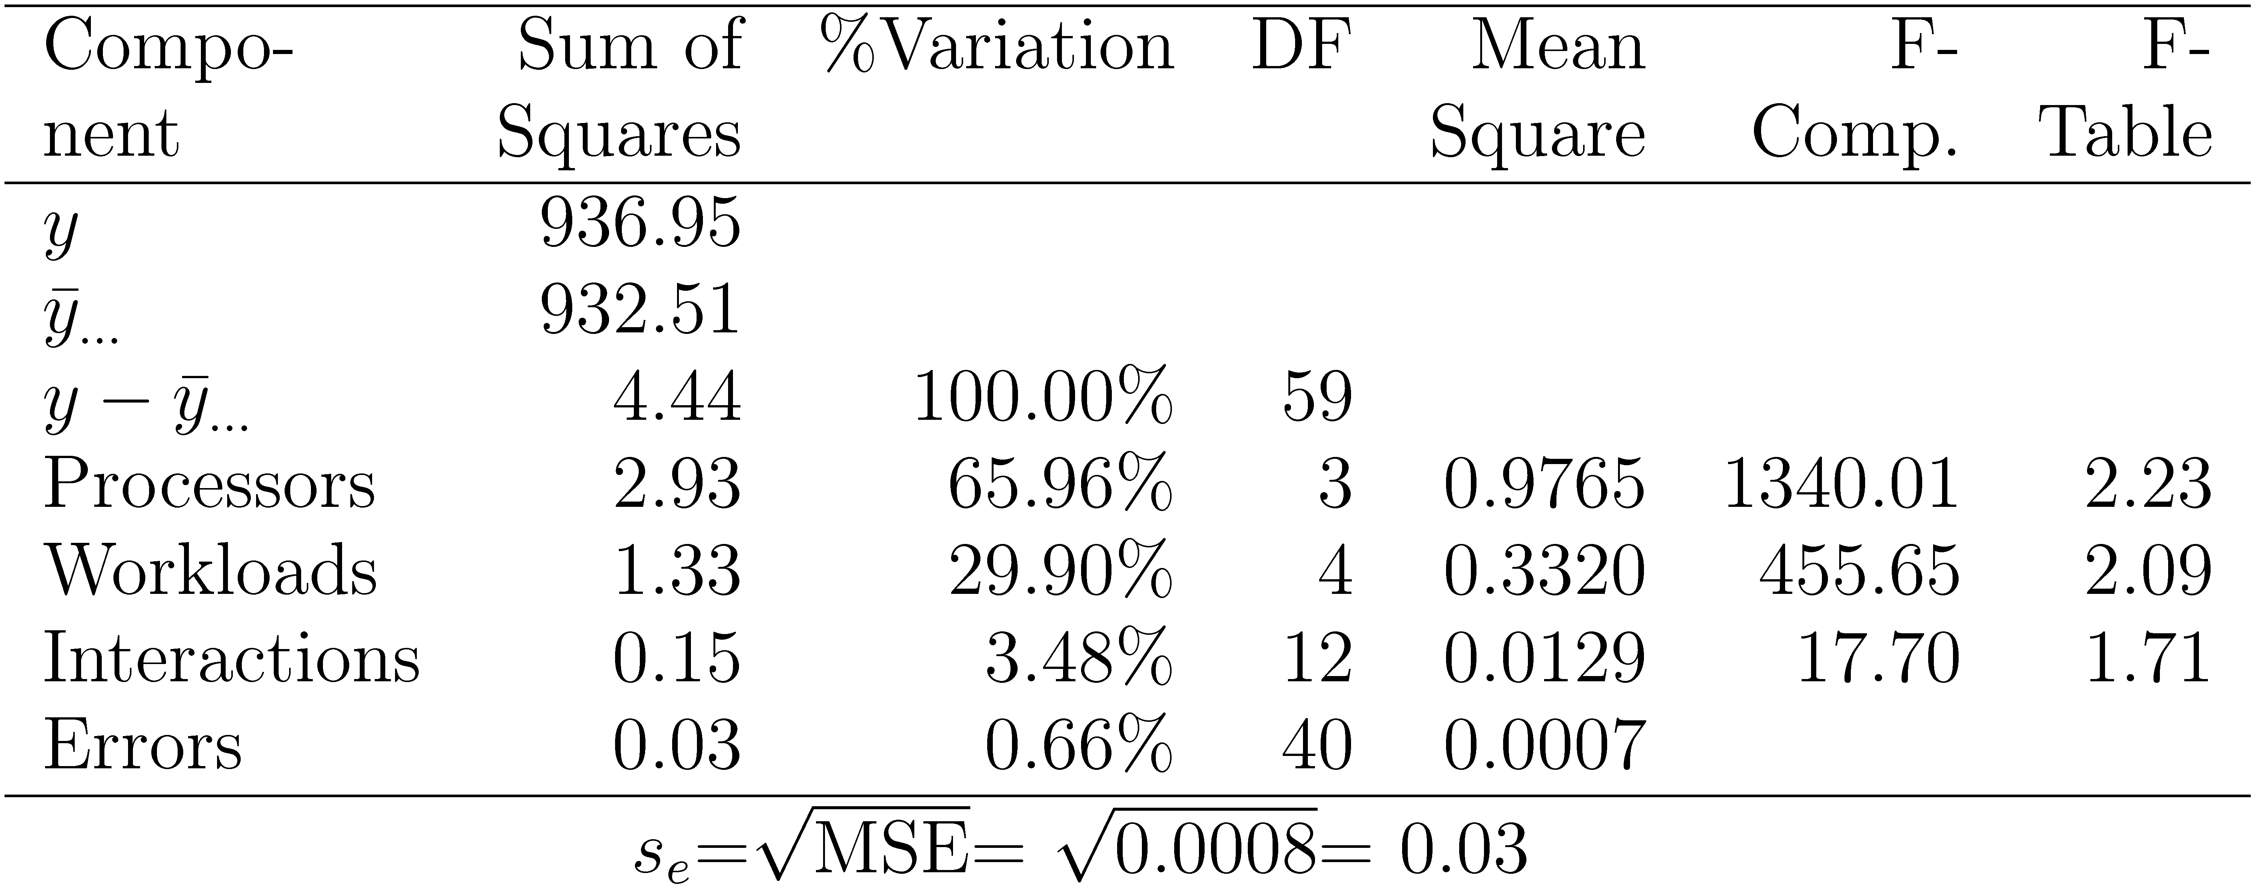
Example 22.4: Code Size Study
All three effects are statistically significant at a significance level of 0.10.

Slide 58
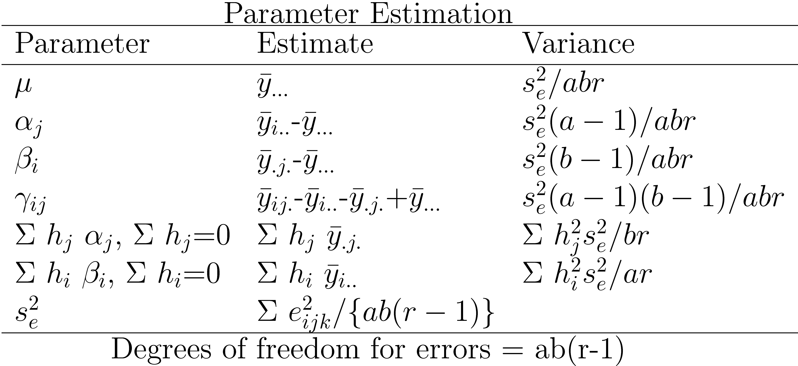
Confidence Intervals For Effects
Use t values at ab(r-1) degrees of freedom for confidence intervals

Slide 59
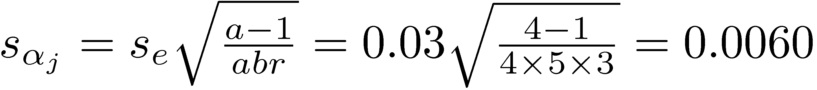
Example 22.5: Code Size Study
From ANOVA table: s_{e}=0.03. The standard deviation of processor effects:
The error degrees of freedom:
ab(r-1) = 40 ⇒ use Normal tables
For 90% confidence, z_{0.95} = 1.645
90% confidence interval for the effect of processor W is:
α₁ ¨ t s_{α1} = -0.2304 ¨ 1.645 £ 0.0060
= -0.2304 ¨ 0.00987
= (-0.2406, -0.2203)
The effect is significant.

Slide 60

Example 22.5: Conf. Intervals (Cont)
The intervals are very narrow.

Slide 61

Example 22.5: CI for Interactions

Slide 62


Example 22.5: Visual Tests
No visible trend.
Approximately linear ) normality is valid.

Slide 63
Two Factors Full Factorial Design without Replications

Slide 64
Overview
Computation of Effects
Estimating Experimental Errors
Allocation of Variation
ANOVA Table
Visual Tests
Confidence Intervals For Effects
Multiplicative Models
Missing Observations

Slide 65
Two Factors Full Factorial Design
Used when there are two parameters that are carefully controlled
Examples:
To compare several processors using several workloads.
To determining two configuration parameters, such as cache and memory sizes
Assumes that the factors are categorical. For quantitative factors, use a regression model.
A full factorial design with two factors A and B having a and b levels requires ab experiments.
First consider the case where each experiment is conducted only once.

Slide 66

Model

Slide 67





Computation of Effects
Averaging the jth column produces:
Since the last two terms are zero, we have:
Similarly, averaging along rows produces:
Averaging all observations produces
Model parameters estimates are:
Easily computed using a tabular arrangement.

Slide 68

Example 21.1: Cache Comparison

Slide 69

Example 21.1: Computation of Effects
An average workload on an average processor requires 72.2 ms of processor time.
The time with two caches is 21.2 ms lower than that on an average processor
The time with one cache is 20.2 ms lower than that on an average processor.
The time without a cache is 41.4 ms higher than the average

Slide 70
Example 21.1 (Cont)
Two-cache - One-cache = 1 ms.
One-cache - No-cache = 41.4-20.2 or 21.2 ms.
The workloads also affect the processor time required.
The ASM workload takes 0.5 ms less than the average.
TECO takes 8.8 ms higher than the average.

Slide 71


Estimating Experimental Errors
Estimated response:
Experimental error:
Sum of squared errors (SSE):
Example: The estimated processor time is:
Error = Measured-Estimated = 54-50.5 = 3.5

Slide 72

Example 21.2: Error Computation
The sum of squared errors is:

Slide 73

Example 21.2: Allocation of Variation
Squaring the model equation:
High percent variation explained ⇒ Cache choice important in processor design.

Slide 74


Analysis of Variance
Degrees of freedoms:
Mean squares:
Computed ratio > F_{[1- α;a-1,(a-1)(b-1)]} ) A is significant at level α.

Slide 75

ANOVA Table

Slide 76

Example 21.3: Cache Comparison
Cache choice significant.
Workloads insignificant

Slide 77


Example 21.4: Visual Tests

Slide 78

Confidence Intervals For Effects
For confidence intervals use t values at (a-1)(b-1) degrees of freedom

Slide 79


Example 21.5: Cache Comparison
Standard deviation of errors:
Standard deviation of the grand mean:
Standard deviation of α_{j}'s:
Standard deviation of β_{i}'s:

Slide 80

Example 21.5 (Cont)
Degrees of freedom for the errors are (a-1)(b-1)=8.
For 90% confidence interval, t_{[0.95;8]}= 1.86.
Confidence interval for the grand mean:
All three cache alternatives are significantly different from the average.

Slide 81

Example 21.5 (Cont)
All workloads, except TECO, are similar to the average and hence to each other.

Slide 82

Example 21.5: CI for Differences
Two-cache and one-cache alternatives are both significantly better than a no cache alternative.
There is no significant difference between two-cache and one-cache alternatives.

Slide 83

Case Study 21.1: Cache Design Alternatives
Multiprocess environment: Five jobs in parallel.
ALL = ASM, TECO, SIEVE, DHRYSTONE, and SORT in parallel.
Processor Time:

Slide 84

Case Study 21.1 on Cache Design (Cont)
Confidence Intervals for Differences:
Conclusion: The two caches do not produce statistically better performance.

Slide 85

Multiplicative Models
Additive model:
If factors multiply ⇒ Use multiplicative model
Example: processors and workloads
Log of response follows an additive model
If the spread in the residuals increases with the mean response ⇒ Use transformation

Slide 86
Case Study 21.2: RISC architectures
Parallelism in time vs parallelism in space
Pipelining vs several units in parallel
Spectrum = HP9000/840 at 125 and 62.5 ns cycle
Scheme86 = Designed at MIT

Slide 87

Cache Study 21.2: Simulation Results
Additive model: ⇒ No significant difference
Easy to see that: Scheme86 = 2 or 3 £ Spectrum125
Spectrum62.5 = 2 £ Spectrum125
Execution Time = Processor Speed £ Workload Size ⇒ Multiplicative model.
Observations skewed. y_{max}/y_{min} > 1000 ⇒ Adding not appropriate

Slide 88

Case Study 21.2: Multiplicative Model
Log Transformation:
Effect of the processors is significant.
The model explains 99.9% of variation as compared to 88% in the additive model.

Slide 89

Case Study 21.2: Confidence Intervals
Scheme86 and Spectrum62.5 are of comparable speed.
Spectrum125 is significantly slower than the other two processors.
Scheme86's time is 0.4584 to 0.6115 times that of Spectrum125 and 0.7886 to 1.0520 times that of Spectrum62.5.
The time on Spectrum125 is 1.4894 to 1.9868 times that on Spectrum62.5.

Slide 90


Cache Study 21.2: Visual Tests

Slide 91

Case Study 21.2: ANOVA
Processors account for only 1% of the variation
Differences in the workloads account for 99%.
⇒ Workloads widely different
⇒ Use more workloads or cover a smaller range.

Slide 92

Case Study 21.3: Processors

Slide 93

Case Study 21.3: Additive Model
Workloads explain 1.4% of the variation.
Only 6.7% of the variation is unexplained.

Slide 94

Case Study 21.3: Multiplicative Model
Both models pass the visual tests equally well.
It is more appropriate to say that processor B takes twice as much time as processor A, than to say that processor B takes 50.7 ms more than processor A.

Slide 95

Case Study 21.3: Intel iAPX 432

Slide 96

Case Study 21.3: ANOVA with Log
Only 0.8% of variation is unexplained.
Workloads explain a much larger percentage of variation than the systems
⇒ the workload selection is poor.

Slide 97

Case Study 21.3: Confidence intervals

Slide 98

Missing Observations
Recommended Method:
Divide the sums by respective number of observations
Adjust the degrees of freedoms of sums of squares
Adjust formulas for standard deviations of effects
Other Alternatives:
Replace the missing value by such that the residual for the missing experiment is zero.
Use y such that SSE is minimum.

Slide 99

Case Study 21.4: RISC-I Execution Times

Slide 100

Case Study 21.5: Using Multiplicative Model

Slide 101

Case Study 21.5: Experimental Errors

Slide 102



Case Study 21.5: Experimental Errors (Cont)
16 independent parameters (μ, α_{j}, and β_{i}) have been computed ⇒ Errors have 60-1-5-10 or 44 degrees of freedom.
The standard deviation of errors is:
The standard deviation of α_{j}:
c_{j} = number of observations in column c_{j}.

Slide 103

Case Study 21.5 (Cont)
The standard deviation of the row effects:
r_{i}=number of observations in the ith row.

Slide 104

Case Study 21.5: CIs for Processor Effects

Slide 105


Case Study 21.5: Visual Tests

Slide 106


Case Study 21.5: Analysis without 68000

Slide 107

Case Study 21.5: RISC-I Code Size

Slide 108

Case Study 21.5: Confidence Intervals

Slide 109


Summary
Two Factor Designs Without Replications
Model:
Effects are computed so that:
Effects:

Slide 110
General Full Factorial Designs With k Factors

Slide 111
Overview
Model
Analysis of a General Design
Informal Methods
Observation Method
Ranking Method
Range Method

Slide 112


General Full Factorial Designs With k Factors
Model: k factors ) 2^{k}-1 effects k main effects
two factor interactions,
three factor interactions,
and so on.
Example: 3 factors A, B, C:

Slide 113



Model Parameters
Analysis: Similar to that with two factors
The sums of squares, degrees of freedom, and F-test also extend as expected. }

Slide 114

Case Study 23.1: Paging Process
Total 81 experiments.

Slide 115

Case Study 23.1 (Cont)
Total Number of Page Swaps
y_{max}/y_{min} = 23134/32 = 723 ⇒ log transformation

Slide 116

Case Study 23.1 (Cont)
Transformed Data For the Paging Study

Slide 117

Case Study 23.1 (Cont)
Effects:
Also
Six two-factor interactions,
Four three-factor interactions, and
One four-factor interaction.

Slide 118

Case Study 23.1: ANOVA Table

Slide 119

Case Study 23.1: Simplified model
Most interactions except DM are small.
Where,

Slide 120

Case Study 23.1: Simplified Model (Cont)
Interactions Between Deck Arrangement and Memory Pages

Slide 121

Case Study 23.1: Error Computation

Slide 122

Case Study 23.1: Visual Test
Almost a straight line.
Outlier was verified.

Slide 123


Case Study 23.1: Final Model
Standard Error = Stdv of sample mean = Stdv of Error

Slide 124
Observation Method
To find the best combination.
Example: Scheduler Design
Three Classes of Jobs:
Word processing
Interactive data processing
Background data processing
Five Factors 2⁵⁻¹ design

Slide 125

Example 23.1: Measured Throughputs

Slide 126
Example 23.1: Conclusions
To get high throughput for word processing jobs,:
There should not be any preemption (A=-1)
The time slice should be large (B=1)
The fairness should be on (E=1)
The settings for queue assignment and re-queueing do not matter.

Slide 127

Ranking Method
Sort the experiments.

Slide 128
Example 23.2: Conclusions
A=-1 (no preemption) is good for word processing jobs and also that A=1 is bad.
B=1 (large time slice) is good for such jobs. No strong negative comment can be made about B=-1.
Given a choice C should be chosen at 1, that is, there should be two queues.
The effect of E is not clear.
If top rows chosen, then E=1 is a good choice.

Slide 129

Range Method
Range = Maximum-Minimum
Factors with large range are important.
Memory size is the most influential factor.
Problem program, deck arrangement, and replacement algorithm are next in order.

Slide 130
Summary
A general k factor design can have k main effects, two factor interactions, three factor interactions, and so on.
Information Methods:
Observation: Find the highest or lowest response
Ranking: Sort all responses
Range: Largest - smallest average response

Slide 131
Exercise 23.1
Using the observation method on data of Table 23.8, find the factor levels that maximize the throughput for interactive jobs (T_{I}). Repeat the problem for background jobs (T_{B}).

Slide 132
Exercise 23.2
Repeat Exercise 23.1 using ranking method.

Slide 133

Homework
Analyze the following results using observation and ranking methods.

Slide 134
2^{k-p} Fractional Factorial Designs

Slide 135
Overview
2^{k-p} Fractional Factorial Designs
Sign Table for a 2^{k-p} Design
Confounding
Other Fractional Factorial Designs
Algebra of Confounding
Design Resolution

Slide 136
2^{k-p} Fractional Factorial Designs
Large number of factors
) large number of experiments
) full factorial design too expensive
) Use a fractional factorial design
2^{k-p} design allows analyzing k factors with only 2^{k-p} experiments.
2^{k-1} design requires only half as many experiments
2^{k-2} design requires only one quarter of the experiments

Slide 137

Example: 2⁷⁻⁴ Design
Study 7 factors with only 8 experiments!

Slide 138
Fractional Design Features
Full factorial design is easy to analyze due to orthogonality of sign vectors.
Fractional factorial designs also use orthogonal vectors. That is:
The sum of each column is zero.
∑_{i} x_{ij} =0 8 j
jth variable, ith experiment.
The sum of the products of any two columns is zero.
∑_{i} x_{ij}x_{il}=0 8 j≠ l
The sum of the squares of each column is 2⁷⁻⁴, that is, 8.
∑_{i} x_{ij}² = 8 8 j

Slide 139



Analysis of Fractional Factorial Designs
Model:
Effects can be computed using inner products.

Slide 140

Example 19.1
Factors A through G explain 37.26%, 4.74%, 43.40%, 6.75%, 0%, 8.06%, and 0.03% of variation, respectively.
⇒ Use only factors C and A for further experimentation.

Slide 141
Sign Table for a 2^{k-p} Design
Steps:
Prepare a sign table for a full factorial design with k-p factors.
Mark the first column I.
Mark the next k-p columns with the k-p factors.
Of the (2^{k-p}-k-p-1) columns on the right, choose p columns and mark them with the p factors which were not chosen in step 1.

Slide 142

Example: 2⁷⁻⁴ Design

Slide 143

Example: 2⁴⁻¹ Design

Slide 144

Confounding
Confounding: Only the combined influence of two or more effects can be computed.

Slide 145



Confounding (Cont)
) Effects of D and ABC are confounded. Not a problem if q_{ABC} is negligible.

Slide 146



Confounding (Cont)
Confounding representation: D=ABC
Other Confoundings:
I=ABCD ) confounding of ABCD with the mean.

Slide 147


Other Fractional Factorial Designs
A fractional factorial design is not unique. 2^{p} different designs.
Confoundings:
Not as good as the previous design.

Slide 148


Algebra of Confounding
Given just one confounding, it is possible to list all other confoundings.
Rules:
I is treated as unity.
Any term with a power of 2 is erased.
Multiplying both sides by A:
Multiplying both sides by B, C, D, and AB:

Slide 149

Algebra of Confounding (Cont)
and so on.
Generator polynomial: I=ABCD
For the second design: I=ABC.
In a 2^{k-p} design, 2^{p} effects are confounded together.

Slide 150


Example 19.7
In the 2⁷⁻⁴ design:
Using products of all subsets:

Slide 151

Example 19.7 (Cont)
Other confoundings:

Slide 152
Design Resolution
Order of an effect = Number of terms
Order of ABCD = 4, order of I = 0.
Order of a confounding = Sum of order of two terms
E.g., AB=CDE is of order 5.
Resolution of a Design
= Minimum of orders of confoundings
Notation: R_{III} = Resolution-III = 2^{k-p}_{III}
Example 1: I=ABCD ⇒ R_{IV} = Resolution-IV = 2⁴⁻¹_{IV}

Slide 153

Design Resolution (Cont)
Example 2:
I = ABD ⇒ R_{III} design.
Example 3:
This is a resolution-III design.
A design of higher resolution is considered a better design.

Slide 154

Case Study 19.1: Latex vs. troff

Slide 155

Case Study 19.1 (Cont)
Design: 2⁶⁻¹ with I=BCDEF

Slide 156

Case Study 19.1: Conclusions
Over 90% of the variation is due to: Bytes, Program, and Equations and a second order interaction.
Text file size were significantly different making it's effect more than that of the programs.
High percentage of variation explained by the ``program £ Equation'' interaction ⇒ Choice of the text formatting program depends upon the number of equations in the text. troff not as good for equations.

Slide 157
Case Study 19.1: Conclusions (Cont)
Low ``Program £ Bytes'' interaction ) Changing the file size affects both programs in a similar manner.
In next phase, reduce range of file sizes. Alternately, increase the number of levels of file sizes.

Slide 158

Case Study 19.2: Scheduler Design
Three classes of jobs: word processing, data processing, and background data processing.
Design: 2⁵⁻¹ with I=ABCDE

Slide 159

Measured Throughputs

Slide 160

Effects and Variation Explained

Slide 161
Case Study 19.2: Conclusions
For word processing throughput (T_{W}): A (Preemption), B (Time slice), and AB are important.
For interactive jobs: E (Fairness), A (preemption), BE, and B (time slice).
For background jobs: A (Preemption), AB, B (Time slice), E (Fairness).
May use different policies for different classes of workloads.
Factor C (queue assignment) or any of its interaction do not have any significant impact on the throughput.
Factor D (Requiring) is not effective.
Preemption (A) impacts all workloads significantly.
Time slice (B) impacts less than preemption.
Fairness (E) is important for interactive jobs and slightly important for background jobs.

Slide 162
Summary
Fractional factorial designs allow a large number of variables to be analyzed with a small number of experiments
Many effects and interactions are confounded
The resolution of a design is the sum of the order of confounded effects
A design with higher resolution is considered better

Slide 163

Exercise 19.1
Analyze the 2⁴⁻¹ design:
Quantify all main effects.
Quantify percentages of variation explained.
Sort the variables in the order of decreasing importance.
List all confoundings.
Can you propose a better design with the same number of experiments.
What is the resolution of the design?

Slide 164
Exercise 19.2
Is it possible to have a 2⁴⁻¹_{III} design? a 2⁴⁻¹_{II} design? 2⁴⁻¹_{IV} design? If yes, give an example.

Slide 165

Homework
Updated Exercise 19.1 Analyze the 2⁴⁻¹ design:
Quantify all main effects.
Quantify percentages of variation explained.
Sort the variables in the order of decreasing importance.
List all confoundings.
Can you propose a better design with the same number of experiments.
What is the resolution of the design?

Slide 166
Simulation

Slide 167
This is a slide title
Here you have a list of items
And some text
But remember not to overload your slides with content
Your audience will listen to you or read the content, but won’t do both.

Slide 168
Want big impact?
Use big image.

Slide 169
Thanks!
Any questions?
You can find me at:
@username
user@mail.me

Slide 170
Credits
Special thanks to all the people who made and released these awesome resources for free:
Presentation template by SlidesCarnival
Photographs by Unsplash

Slide 171
Presentation design
This presentations uses the following typographies and colors:
Titles: Raleway
Body copy: Lato
You can download the fonts on these pages:
https://www.fontsquirrel.com/fonts/raleway
https://www.fontsquirrel.com/fonts/lato
Dark blue #2185c5
Light blue #7ecefd
Yellow #ff9715
Magenta #f20253
Dark gray #677480
Light gray #97abbc
You don’t need to keep this slide in your presentation. It’s only here to serve you as a design guide if you need to create new slides or download the fonts to edit the presentation in PowerPoint®

Slide 172
SlidesCarnival icons are editable shapes.
This means that you can:
Resize them without losing quality.
Change fill color and opacity.
Change line color, width and style.
Isn’t that nice? :)
Examples:

Slide 173
😉
Now you can use any emoji as an icon!
And of course it resizes without losing quality and you can change the color.
How? Follow Google instructions https://twitter.com/googledocs/status/730087240156643328
✋👆👉👍👤👦👧👨👩👪💃🏃💑❤😂😉😋😒😭👶😸🐟🍒🍔💣📌📖🔨🎃🎈🎨🏈🏰🌏🔌🔑 and many more...

